Slide 1



Welcome to Year 5!
5F
5T
Miss Fernandes
Mrs Thomson
Bucks Music Trust
Lingotots
Mrs Nagar, Mrs Bunday, Miss Janusz, Mrs Doran
Year5@gmglt.co.uk

Slide 2

Year 5 so far…..
The children had a great first day.
They are getting to know the new adults that are working with them.
They are getting used to the new timetable and the work rate!

Slide 3

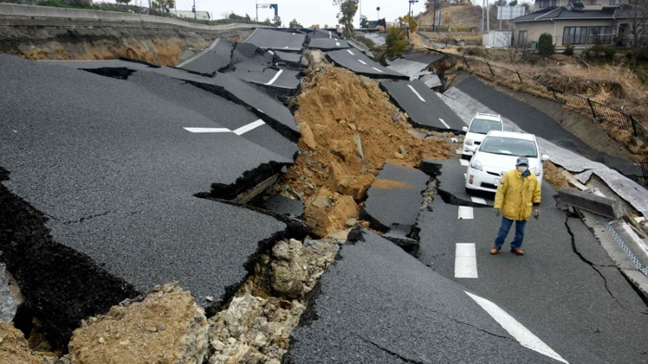
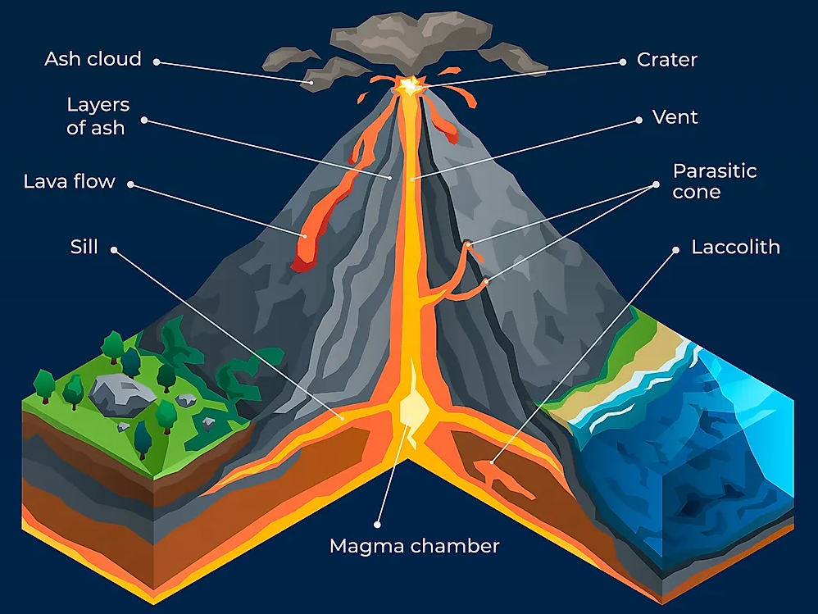
The WAC topic for this term…
Earthquakes, Mountains and Volcanoes!
Hook day – this Friday!
Resilience
Power
Adversity
Community
How can change impact our lives?

Slide 4
Curriculum Overview
Autumn term 1 - How can change impact our lives?
Maths: Place Value (including Roman numerals), addition and subtraction
English: fiction unit and poetry unit
Geography: Earthquakes, Mountains, Volcanoes
Science: Forces, Earth and Space
PSHE: Being me in my world
RE: Why do people have to stand up for what they believe in
French: Lingotots
Music: Singing and listening skills, Music from around the world, practising for Young Voices
Physical Education: Gymnastics
Games: Handball, Netball and Football
Computing: Systems and Networks

Slide 5

Support in School
Intervention and booster groups where necessary- formal and informal
Keep up, not catch up – KUNCU
Assessment week every
term to check where their learning is at so we can tailor the learning to their gaps.
Autumn - w/c 5th October.

Slide 6
Organisation
Maths home learning- set weekly on White Rose Infinity.
SPAG and Spelling homework – set weekly on EdShed
Reading book- recommended list on website
Pencil cases (info on next slide)
PE Kit days:
  Games: Tuesday for both classes
  5F: Friday (except this week)
  5T: Thursday (tomorrow!)

Slide 7
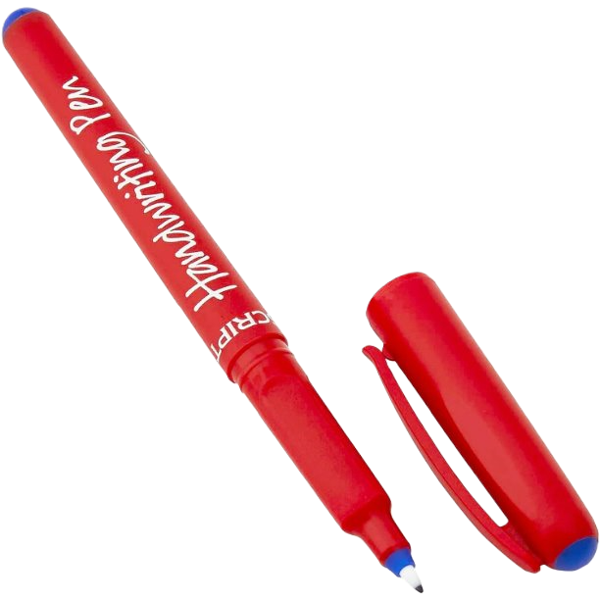
PENCIL CASES
Pencil
Purple pen
Blue handwriting pen – no biro/erasable pens.
Ruler
Rubber and sharpener
Glue stick
Coloured pencils – red, blue, green, yellow
Scissors
Whiteboard pen
Labels please!

Slide 8
Expectations
Children in school for 8:40 to complete morning work.
Shoulder length hair needs to be tied back.
Hats are not to be worn indoors.
Stud earrings can be worn in school, if they cannot be taken out then they should be taped up for PE and games.
Black school shoes should be worn - not trainers.
PE kit worn on PE days.
1 Pencil case brought into school each day.
Home learning completed.
Unless agreed with teacher, no fidget toys or other toys on the desk.
  Fidgets need to be small and silent – they should NOT be a distraction for the child or other learners.

Slide 9
Fidgets:
Unless pre-agreed with the class teacher, no fidget toys or other toys at school.
Fidgets need to be small and silent.
They are there as a support - they should NOT be a distraction for the child or other learners.
Children also need to be taught how to use them effectively e.g. under table/in pocket, tying a knot in string etc.

Slide 10
Assessments
Each term we have PiXL assessments, these are:
1 arithmetic paper
2 reasoning and problem-solving papers
1 reading paper
1 SPAG paper (spelling, punctuation and grammar)
1 spelling test

Slide 11
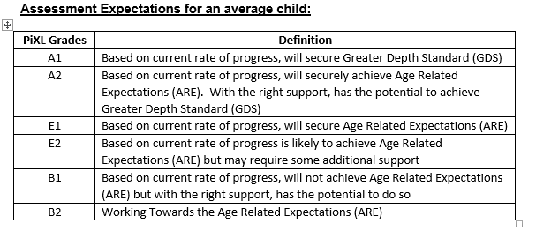
Assessments

Slide 12

Home learning and how you can help...
Reading Records
Maths – in line with weekly objectives. These will be set on White Rose Infinity.
Spelling rules will be sent home weekly via Spelling Shed. The lists will be live from Friday after a spelling lesson and the children will be tested the following Friday. There will also be optional SPAG.
Times tables – encourage your children to go on TTRS and work on times tables, in Year 5 the children really do need to know up to 12 so they can re-call these quickly.
Starting next Friday!

Slide 13

It’s not all learning at desks...
Trips, talks and visits – Looking at going to the Natural History Museum and a trip to Warwick Castle
Year 5 Young Voices – 2nd February – O2 Arena

Slide 14
Stone Farm!
Residential Trip to Stone Farm Study Centre
Monday 10th – 14th May 2026
Stone Farm Study Centre - https://www.stonefarmstudycentre.co.uk/
Staying on farm
Surf lessons
Day at the Eden Project
Paignton zoo

Slide 15
Forest School - volunteers needed!
Rolling out a timetable for all year groups.
Looking for parent volunteers on:
Mondays – 13:15 – 15:15
Tuesdays – 13:15 – 15:15
Please email the office if you are keen:
office@gmglt.co.uk

Slide 16
The Brilliant Book!
If children get in the ‘brilliant book’ on a Friday, they have the option to take home the class mascot.
Friday → Wednesday
They can write in the diary if they would like.

Slide 17
Finally...
It’s going to be a challenging but rewarding year
The class page on the website is regularly updated and this should be where you look first (it will be ship shape by Friday)
Please feel free to ask us any questions you may have, the year group email is year5@gmglt.co.uk
Thank you!

