Slide 1
Use a or an correctly
Stage 3 Word 2.2
National Curriculum Teaching Point:
Use of forms a or an according to whether the next word begins with a consonant or a vowel [for example, a rock, an open box]

Slide 2
Insert a or an into these sentences.
an
When we went to the zoo we saw elephant.
a
Eve went to the shop and bought toy unicorn.
An
ice cream is a treat on a hot day.
a
Ruth stayed in hotel.

Slide 3
Insert a or an into these sentences.
a
Have you got brother or sister?
an
It took hour to drive to the seaside.
an
I need umbrella today because it is raining.
a
James would like to learn how to ride horse.

Slide 4
Has a/an been used correctly in these sentences? How do you know?
James stroked a dog.
James stroked a dog.
A avalanche fell down the cliff face.
An avalanche fell down the cliff face.
Ahmed cried as he chopped an onion.
Ahmed cried as he chopped a onion.
It took me an hour to do my homework.
It took me an hour to do my homework.
Notes:
Hour needs “an” in front of it because the “h” is not sounded, making the “ow” vowel sound.

Slide 5
Has a/an been used correctly in these sentences? How do you know?
I had an apple for my snack.
I had an apple for my snack.
It was a easy book to read.
It was an easy book to read.
I want to see a giraffe at the zoo.
I want to see an giraffe at the zoo.
Eve put a pencil case and book in her bag.
Eve put a pencil case and book in her bag.
Notes:
Hour needs “an” in front of it because the “h” is not sounded, making the “ow” vowel sound.

Slide 6




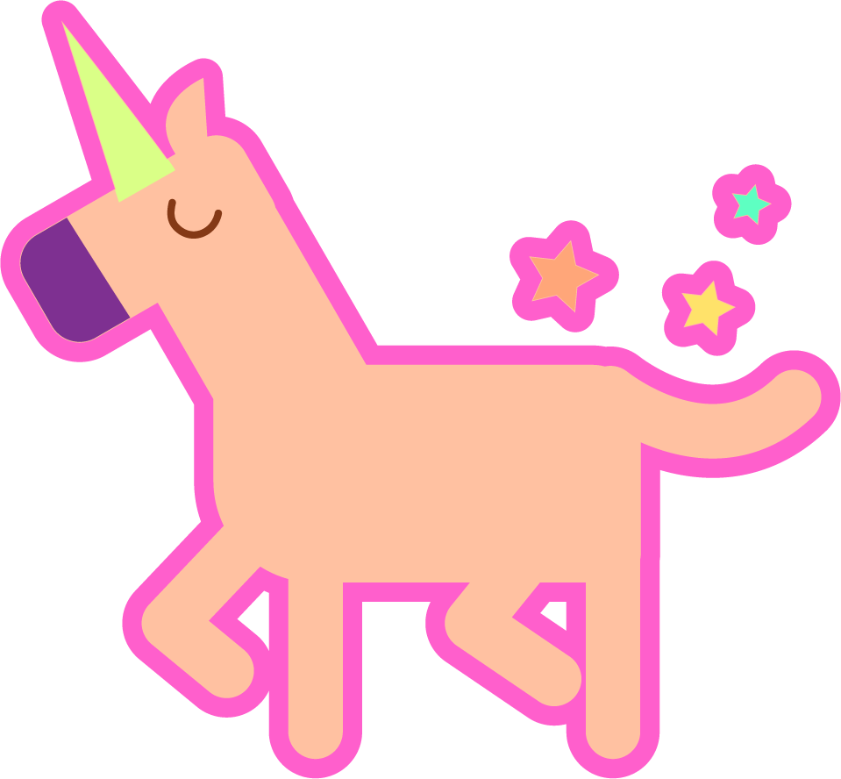



Put these nouns into your own sentences using
a or an correctly.
Notes:
Various answers are possible. The pictures can also be interpreted in different ways. For example, the clock could be clock, or time, or hour. The jug could be jug or an orange jug, or juice in a jug.

Slide 7
Quizshed code:

