Slide 1
Vowels and consonants with a or an
Stage 3 Word 2.1
National Curriculum Teaching Point:
Use of forms a or an according to whether the next word begins with a consonant or a vowel [for example, a rock, an open box]

Slide 2
What are vowels and consonants?
Words in English are built from 26 letters.
Some are vowels and some are consonants.
b
c
d
f
g
h
a
e
i
o
u
j
p
q
k
l
m
n
r
s
t
v
w
x
y
z
vowels
consonants

Slide 3
Sort the letters into the correct category.
p
s
t
u
m
i
j
w
e
k
z
r
o
a
c
d
vowels
consonants

Slide 4
Which words begin with a vowel?
Which begin with a consonant?
umbrella
chair
hotel
phone
elephant
sausage
tiger
orange
ambulance
book
ice cream
jumper
vowels
consonants

Slide 5
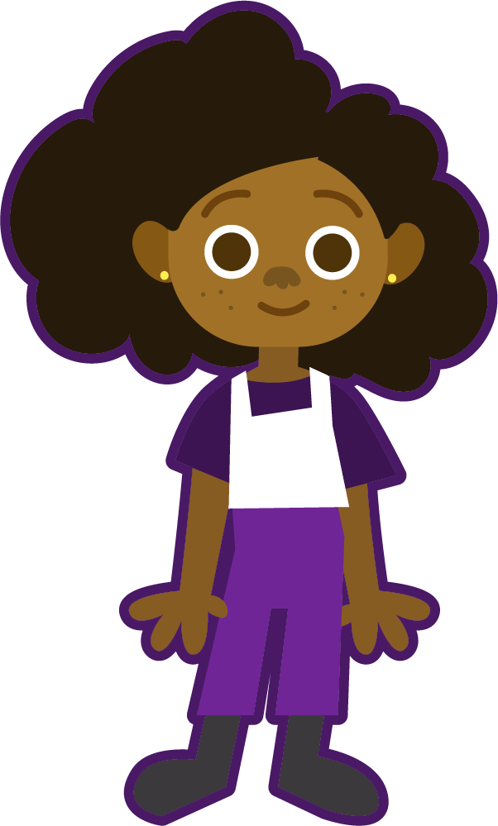
If a word begins with a vowel sound, we need to put “an” in front of it. Try saying them with just an “a”. It’s really difficult!
a apple
an apple
a uncle
an uncle
a igloo
an igloo
a elephant
an elephant

Slide 6



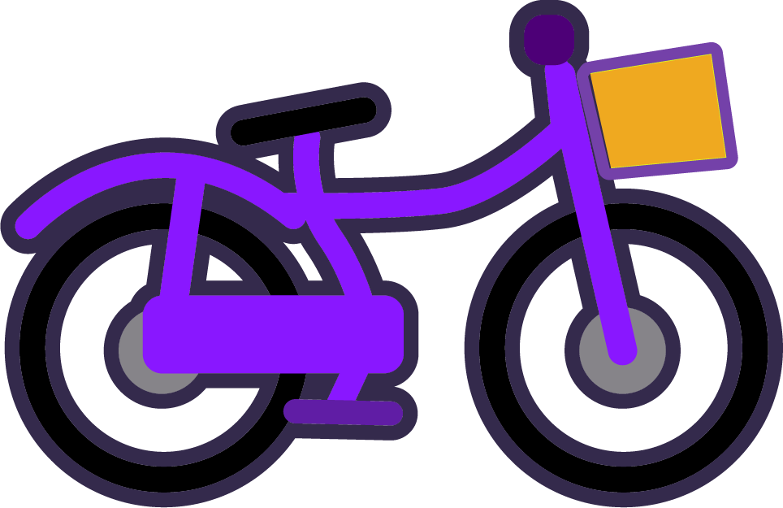






Would you use a or an in front of these nouns?
Try saying them to help.
a
an
a boat
a bike
a dog
an apple
an alien
an eagle
a trophy
a toothbrush
an onion
a pizza

Slide 7
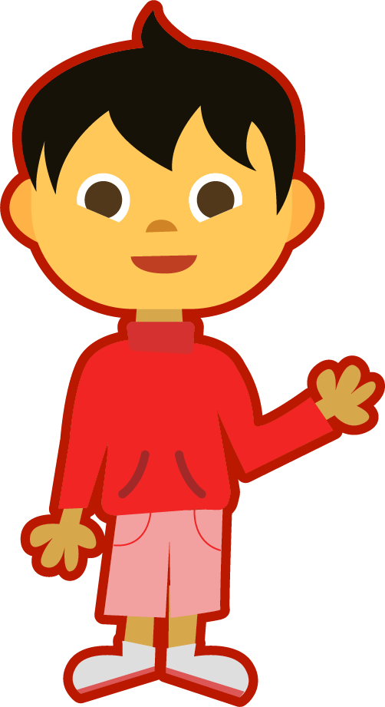
Make a list of nouns. Say them aloud to hear whether it starts with a vowel sound. Sort them into needing a or an in front of them.

Slide 8
Quizshed code:

