Slide 1
The prefix “un”.
Stage 3 Word 1.3
National Curriculum Teaching Point:
Formation of nouns using a range of prefixes [for example super-, anti-, auto-]

Slide 2
A prefix is letters added at the beginning of a root word, which changes its meaning.
Here are some prefixes:
un- | anti- | super- | auto-

Slide 3
Add the prefix “un” to these root words. How does it change the meaning?
happy
unhappy
sure
unsure
stable
unstable

Slide 4
Add the prefix “un” to these root words. How does it change the meaning?
tidy
untidy
able
unable
clear
unclear

Slide 5
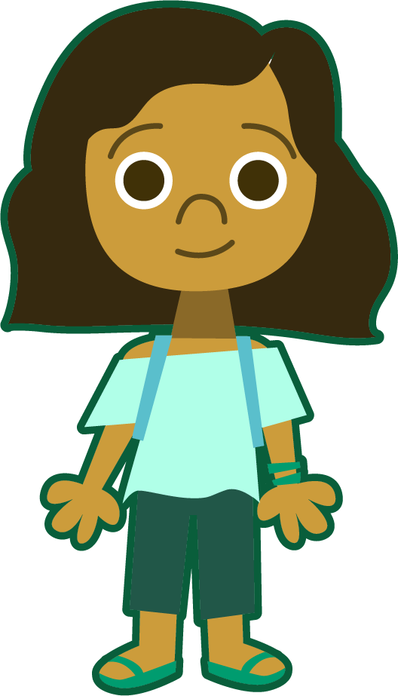
“Un-” means not. By adding the prefix un- you are creating an antonym (a word with the opposite meaning to the root word).

Slide 6
Un-
Put “un” in front of these root words. Which makes a new word?
What does it mean?
unhappy
unstable
happy
sonic
stable
unimportant
important
bacterial
matic
market
unwritten
written
biography

Slide 7
Which “un” word would you use in these sentences?
Jamal felt un- because he lost the race.
The children left the books in an un- pile.
Yasmin went home because she felt un-.
well
happy
tidy

Slide 8
Which “un” word would you use in these sentences?
Eve was un- to do her homework.
It was un- that my brother had more sweets than me.
I can’t wait to un- my presents.
able
wrap
fair

Slide 9
Which “un” word would you use in these sentences?
James spotted an un- bird on his walk.
The story Ruth heard was un-
Eating too much chocolate is un-
true
usual
healthy

Slide 10
market
certain
cover
true
un-
lock
Which new words can you make by adding un-? What do they mean?
allow
care
comfortable

Slide 11
Add un- to these root words then put each of them in a sentence.
finished
lock
comfortable
certain
healthy
usual
Notes:
Various answers possible.

Slide 12
Quizshed code:

