Slide 1
Identify and sort nouns
Stage 3 Word 1.1
National Curriculum Teaching Point:
Formation of nouns using a range of prefixes

Slide 2
There are 4 main word classes. Can you match the word to its classification?
quickly
noun
dog
adjective
running
verb
fluffy
adverb

Slide 3
Sort the words into the correct classification
green
swiftly
swimming
drinking
football
sleepily
tree
shiver
dirty
noisily
tiny
pencil
noun
adjective
verb
adverb

Slide 4
Identify the word classes in the sentence.
verb
Eve and James were playing lazily with the old football.
adverb
adjective
noun

Slide 5




A noun describes a person, place, thing, or idea.
Ruth
garden
bike
time

Slide 6
Which words are nouns?
London
running
table
Nouns
Not nouns
disappointment
heavy
cat

Slide 7
Which words are nouns?
school
cold
Spain
Nouns
Not nouns
happily
jumping
hairbrush

Slide 8
Which words are nouns?
silently
education
kindly
Nouns
Not nouns
Ahmed
book
playing

Slide 9


There are different types of noun.
Objects and things that don’t start with a capital letter.
Common nouns
Can you think of anymore?
love

Slide 10
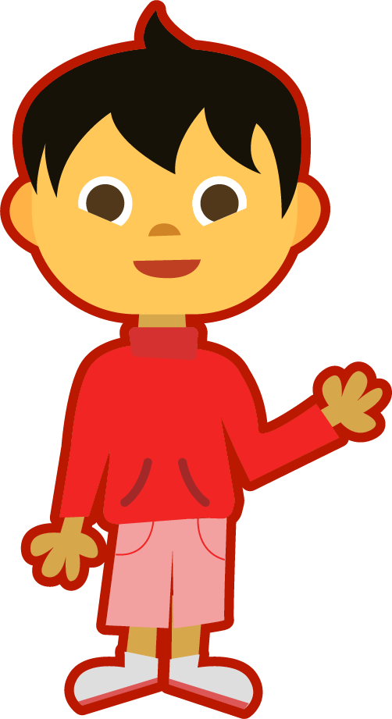
There are different types of noun.
Chen
The name of a person or place. They start with a capital letter.
Proper nouns
India
High Street
Can you think of anymore?

Slide 11

There are different types of noun.
A person, place or object that you can touch.
Concrete nouns
Can you think of anymore?

Slide 12
There are different types of noun.
A thing that cannot be touched or seen
love
Abstract nouns
success
Can you think of anymore?
education

Slide 13
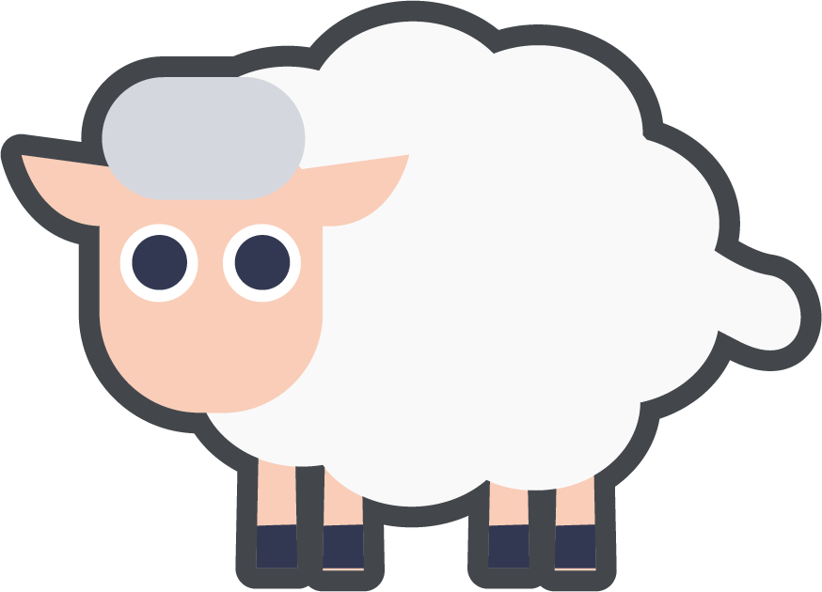

There are different types of noun.
A herd of sheep
A group of things.
Collective nouns
A bunch of flowers
Can you think of anymore?
A choir = a group of singers

Slide 14
Identify the nouns in the sentence.
Yasmin kicked the ball over the wall and into Mr Jones’ garden.
Yasmin
ball
wall
Mr Jones’
garden

Slide 15
Identify the nouns in the sentence.
The love Eve felt for her baby brother was huge.
love
Eve
baby brother

Slide 16
Identify the nouns in the sentence.
We went on holiday to Wales and stayed in a caravan.
holiday
Wales
caravan

Slide 17
Identify the nouns in this paragraph.
internet
network
The internet is a world-wide network of computers that enables them to “talk” to each other. The internet is used to send communications, look up information and even to go shopping!
computers
internet
communications
information

Slide 18
Quizshed code:

