Slide 1
Identifying and sorting conjunctions, determiners and prepositions.
Stage 5 Word 1.2
National Curriculum Teaching Point:
Converting nouns or adjectives into verbs using suffixes [for example, -ate; -ise; -ify]
Key vocabulary: conjunction, determiner, preposition
Notes:
Identifying and sorting conjunctions, determiners and prepositions

Slide 2

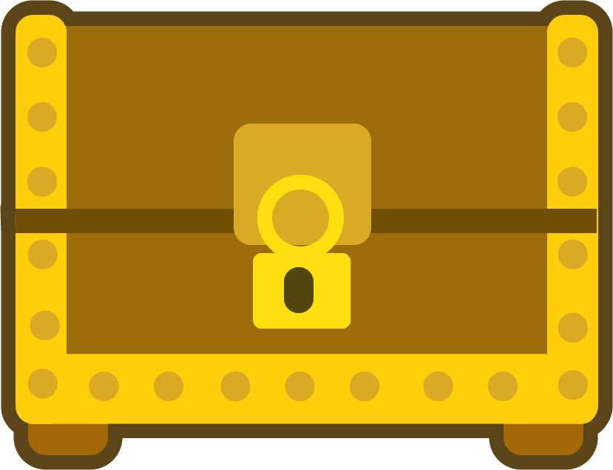
How might this paragraph be improved?
The pirate was angry. The treasure chest was empty. All his hard work was for nothing.
check
The pirate was angry because the treasure chest was empty and all his hard work was for nothing.
We can use conjunctions to avoid a series of short, simple sentences.
Click to find out more.
here

Slide 3


Conjunctions
Conjunctions are words or phrases that join parts of a sentence and linked ideas together.
Here are some examples:
Jamal was hungry, so he ate an apple.
Ruth would be late for school if she didn’t get up soon.
They stayed at home all day because it was raining.

Slide 4

Conjunction spotting
Conjunctions can be found within sentences as you’ve already seen; some, though, can start sentences.
Ruth would be late for school if she didn’t get up soon.
They stayed at home all day because it was raining.
click here
If she didn’t get up soon, Ruth would be late for school.
click here
Because it was raining, they stayed at home all day.

Slide 5
Conjunction spotting
Subordinating conjunctions can appear within sentences, but can start them, too.
Here are some examples of subordinating conjunctions.
click here
as
before
although
because
until
since
when
if
after

Slide 6
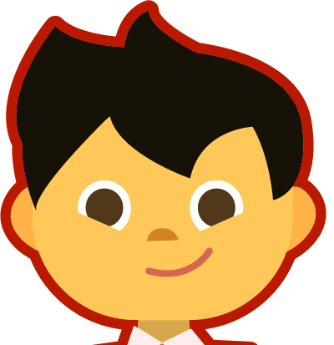
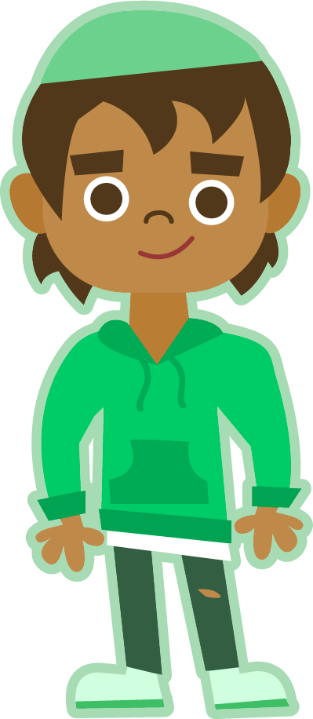
Conjunction spotting
Coordinating conjunctions appear within sentences, but are rarely used to start them.
There are seven to remember:
for
F
A
N
B
O
Y
S
and
nor
but
or
yet
so

Slide 7
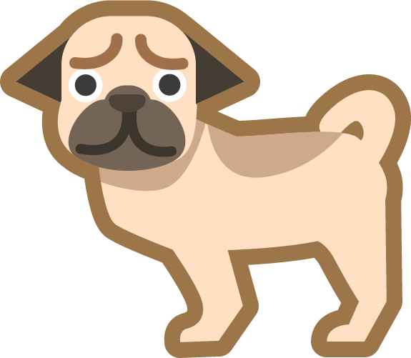
Can you spot the conjunctions in these sentences?
Are they coordinating or subordinating?
Eve was thrilled when she saw the hotel she would be
staying in.
Since the cinema was full, no more people were let in, but
a few tried to sneak through.
I fed the dog and I washed the car.
conjunction
(subordinating)
check
conjunction
(coordinating)
conjunction
(subordinating)
check
conjunction
(coordinating)
check

Slide 8



Determiners
Determiners introduce nouns. They come before nouns and before any adjectives that describe the nouns.
click here
click here
click here
these beautiful flowers
the blue dolphin
two TVs

Slide 9
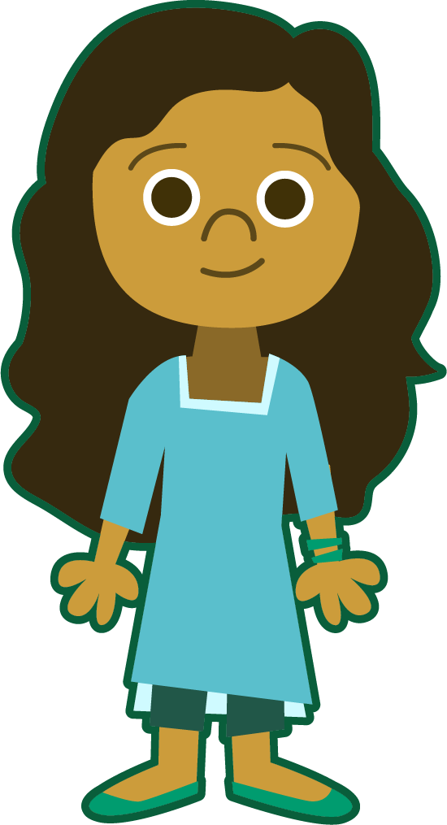
Determiners
There are many kinds of determiner.
Articles – a, an, the
the girl
an elephant
a cake
Quantifiers and numbers – telling you how many
a few cookies
many houses
six footballs
Demonstratives
– demonstrating
this book
that pen
those laptops
Possessive determiners
– showing possession
my leg
your homework
her fish

Slide 10
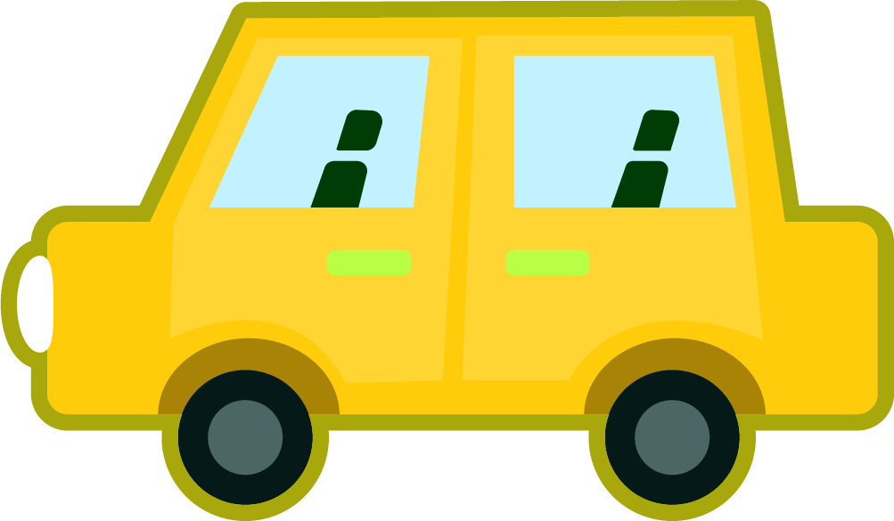
Find the determiners in this paragraph
That email is from my cousin and his wife. Their car was being fixed by the mechanic, so they had to get a taxi to the airport. It took two days to fix the problem.
check

Slide 11


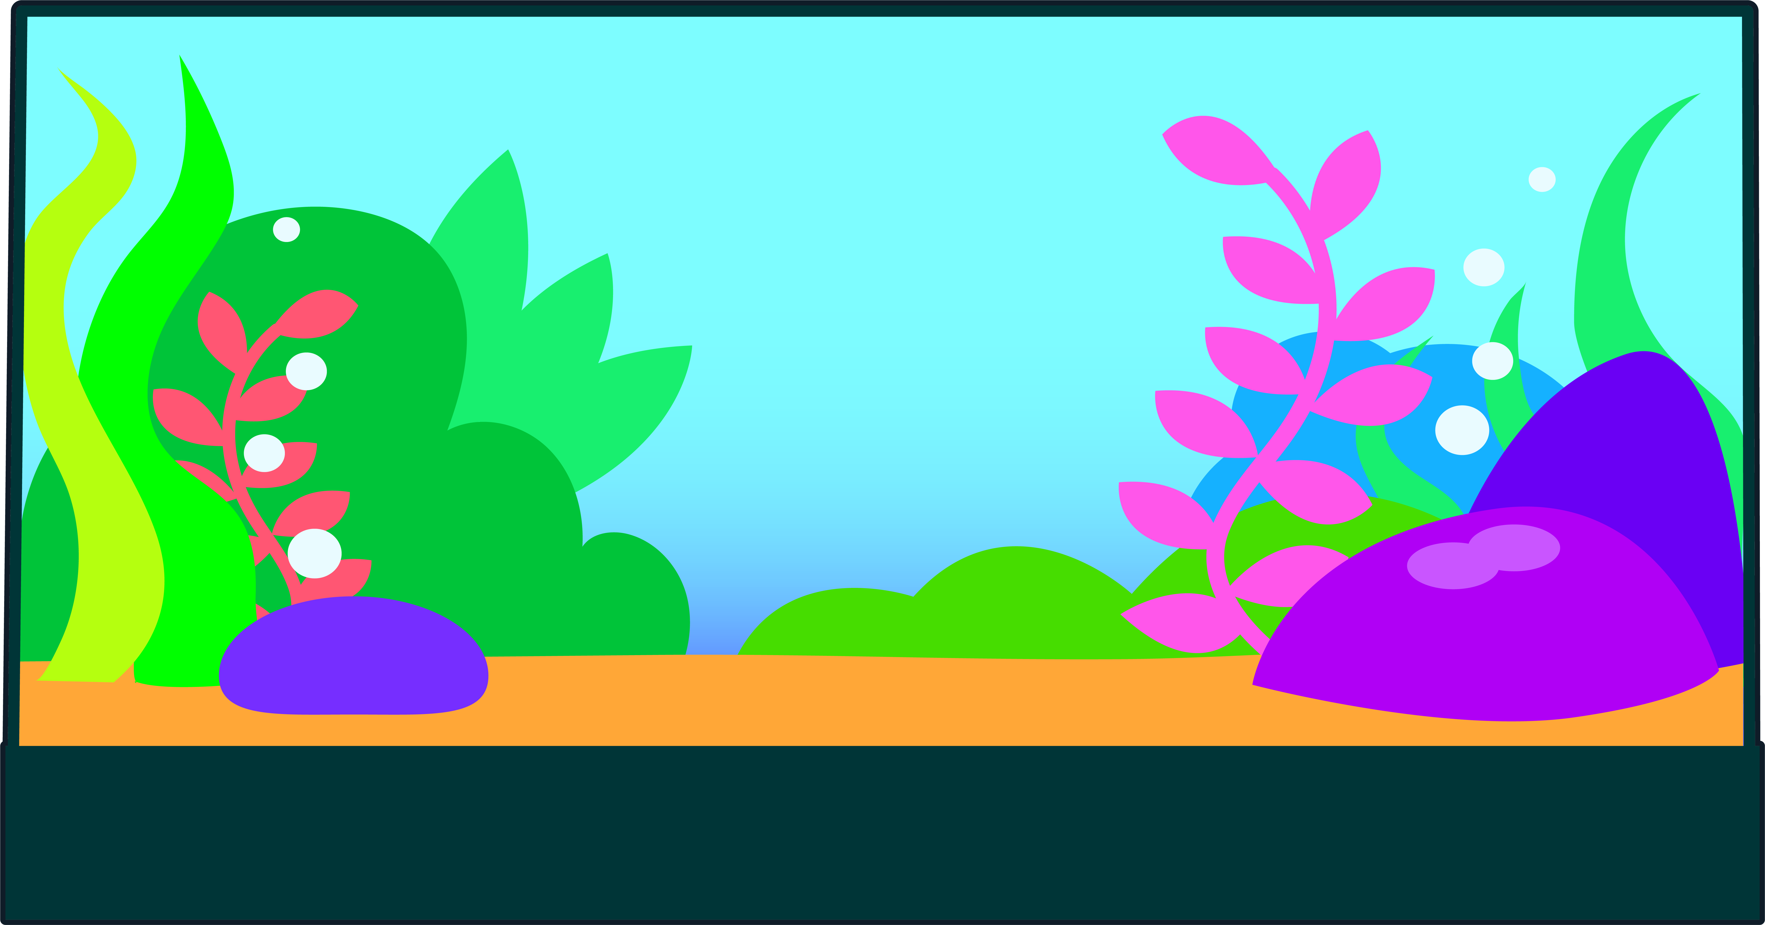
Prepositions
Prepositions tell you where something is or when something happens in relation to something else.
The cat is inside the box.
The cat is under the box.
The cat is next to the box.
The cat is on the fish tank.

Slide 12
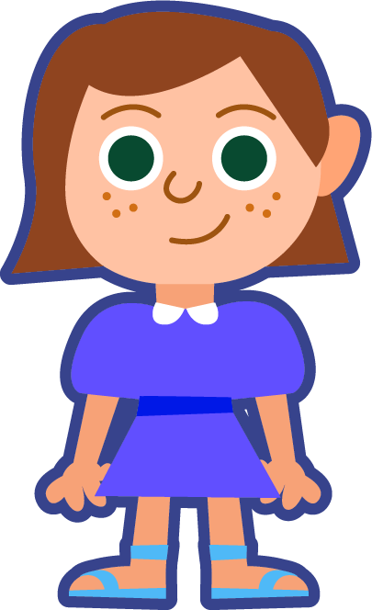


Prepositions
Prepositions tell you where something is or when something happens in relation to something else.
Ruth is going bowling at 5 o’clock.
Ruth is going bowling before dinner.
Ruth is going bowling after lunch.

Slide 13
Which of these are prepositions?
those
because
on
below
after
before
opposite
behind
when
fall
stop
until
during

Slide 14

Read this short paragraph. Which word classes do the words in red belong to? Make your decision and click on the words to check.
conjunctions
determiners
Fourteen
turtles were discovered today supermarket in York. creatures were hiding a parked lorry police received anonymous phone call. Specialist teams have been called a vet is monitoring the reptiles,
they are thought to be in good health.
outside
a
The
under
when
an
prepositions
and
although

Slide 15
Quizshed code:

