Slide 1
Identifying clauses and phrases at the start of sentences and embedded within sentences
Stage 5 Punctuation 2.1-2.2
National Curriculum Teaching Point:
Use of commas to clarify meaning or avoid ambiguity
Key vocabulary: clause, phrase

Slide 2

Adverbs (single words) and adverbial phrases (more than one word) tell us how, how often, where or when something happened.
Adverbial phrases can also tell us why something happened.
To beat the traffic, the teacher left for work early.
Notes:
Teaching point: adverbs and adverbial phrases are both adverbials – adverbials are words or phrases that modify a noun and provide the information outlined above.

Slide 3



Ruth has written this sentence. What is missing?
,
Tomorrow morning I will go bowling.
‘Tomorrow morning’ is an adverbial phrase, telling us when Ruth will go bowling.
It is a fronted adverbial in this sentence as it appears before the verb (‘go’).
We place a comma after the fronted adverbial to connect it to the rest of the sentence.

Slide 4
Can you spot the fronted adverbials in these sentences?
Where would you place commas?
,
Running at top speed Jamal caught the bus.
Check
,
Eating as quickly as she could Yasmin finished her lunch and went to play.
Check

Slide 5

Sometimes, we can place a clause (a group of words containing a subject AND a verb) at the start of a sentence.
Although he was unhappy, he agreed to hold the centipede.
Notice how we still need the comma to connect the clause to the rest of the sentence.
Notes:
Clauses are distinct from phrases in that phrases are groups of words that do not contain a subject AND a verb. They may contain a subject or a verb, but never both.

Slide 6

Add commas to these sentences.
,
After a while the Tyrannosaurus finished devouring its prey.
Check
,
When he had read the book he was asked to write a review.
Check
,
Suddenly a noise came from out of nowhere.
Check

Slide 7




In which of these sentences has the comma been used correctly?
,
With his eyes wide with excitement Ahmed watched the octopus in the tank.
Sighing happily, Chen picked up the glass of milkshake.

Slide 8
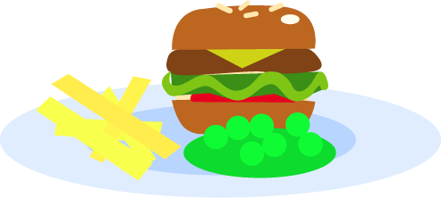
We can place phrases and clauses within sentences, too.
We call these embedded phrases and clauses.
A burger with chips and salad, which was Eve’s favourite dish, was served at the restaurant.
Notice the commas at the start and end of the embedded clause.

Slide 9

Identify the embedded phrases/clauses in these sentences and add the commas.
,
,
The teacher Mrs Jones was liked by all her pupils.
Check
,
,
An orange boat with no-one inside it was spotted floating close to the beach.
Check
,
,
George who is our elderly pet dog still enjoys walks.
Check

Slide 10


Unjumble these words to create a sentence containing an embedded phrase.
Remember appropriate punctuation.
swooping
our
down
quickly
seagull
food
stole
the
The
,
,
.

Slide 11


Unjumble these words to create a sentence containing an embedded phrase.
Remember appropriate punctuation.
named
our
fish
Jim
tank
lives
in
a
Our
,
,
.

Slide 12
In which of these sentences have commas been used correctly?
Our field trip, which took place yesterday, was very informative.
Nodding her head, Yasmin showed that she was happy with the decision.
Mr Clark our headteacher has an office that is next to the hall.
,
,

Slide 13
Quizshed code:

