Slide 1
Identify and use the correct speech punctuation in a sentence.
Stage 4 Punctuation P2.2 – P2.4
National Curriculum Teaching Point:
Use of inverted commas and other punctuation to indicate direct speech; end punctuation with inverted commas
Key vocabulary: punctuation, inverted comma, comma, speech

Slide 2

Remember that we use inverted commas around direct speech in a sentence.
I love grammar!
“I love grammar”
I love grammar Ahmed exclaimed.
“I love grammar!”
We also put some punctuation before the second inverted comma.

Slide 3

What punctuation should go before the second inverted comma here?
“Where are we going?” asked James.
“Where are we going” asked James.

Slide 4
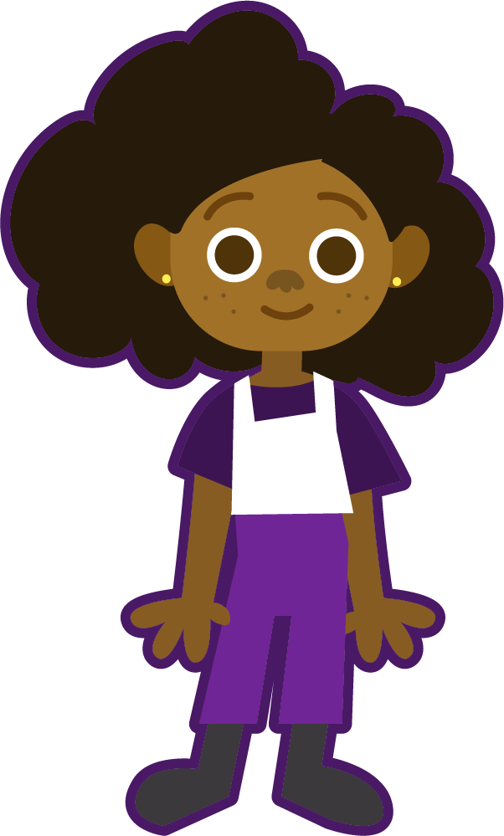
What punctuation should go before the second inverted comma here?
“It’s cold out today,” said Eve.
“It’s cold out today” said Eve.
Even though ‘It’s cold out today’ is everything Eve says, the sentence doesn’t end until after the reporting clause (‘said Eve’). We put a comma at the end of her speech and a full stop at the end of the whole sentence.

Slide 5

Has this sentence been punctuated correctly?
“Can you hear that?” questioned Yasmin nervously.
“Can you hear that questioned Yasmin?” nervously.
This isn’t correct. The spoken part is ‘Can you hear that?’

Slide 6
Has this sentence been punctuated correctly?
“I can’t wait until tomorrow!” Exclaimed Yasmin.
“I can’t wait until tomorrow!” exclaimed Yasmin.
This isn’t correct. The sentence doesn’t end until after ‘Yasmin’ so there shouldn’t be a capital letter after the speech.

Slide 7
Has this sentence been punctuated correctly?
“I wish I could go back in time,” said Yasmin thoughtfully.
Yes! This sentence is correct.

Slide 8

Has this sentence been punctuated correctly?
“I’ve lost my pen. Can I borrow yours?” asked Ruth.
“I’ve lost my pen.” Can I borrow yours? asked Ruth.
This isn’t correct. Think about which parts are spoken by Ruth.

Slide 9

Where should the punctuation go in this sentence?
capital letter to start the sentence
full stop to end the sentence
“
”
W
?
where do you live asked Jamal
.
inverted commas to show the bits being said
question mark before the inverted comma

Slide 10
What’s the same and what’s different between these two sentences?
“Stop right there!” shouted the policeman.
The policeman shouted, “Stop right there!”
What do you notice about the punctuation in the second sentence?

Slide 11
Let’s take a look at the punctuation.
capital letter to start the sentence
inverted commas around the spoken part
The policeman shouted, “Stop right there!”
comma before the speech punctuation
sentence-ending punctuation before the inverted comma
capital letter to start the speech

Slide 12
Let’s build a sentence.
reporting clause to show who is speaking, beginning with a capital letter
opening inverted comma
closing inverted comma
“
”
Chen said quietly
,
The baby is sleeping.
spoken part beginning with a capital letter and ending with a full stop (or exclamation mark or question mark)
comma before the speech punctuation

Slide 13
Sometimes, it’s interesting to put the reporting clause within the speech.
“If you set your mind to it,” Chen said, “you can accomplish anything.”
Talk to your partner. Can you work out the punctuation rules?

Slide 14
The speech is split by the reporting clause so there are two pairs of inverted commas.
“If you set your mind to it,” Chen said, “you can accomplish anything.”

Slide 15
In this example, we don’t need a capital letter on the second part of the speech because it isn’t the start of Chen’s sentence.
“If you set your mind to it,” Chen said, “you can accomplish anything.”
A comma goes before the closing inverted comma of the first part of the speech and before the opening inverted comma of the second part of the speech.

Slide 16
Has this sentence been punctuated correctly?
Ruth turned to Ahmed and said, “Will you help me?
Ruth turned to Ahmed and said, “will you help me?”
This isn’t correct. The speech must start with a capital letter.

Slide 17
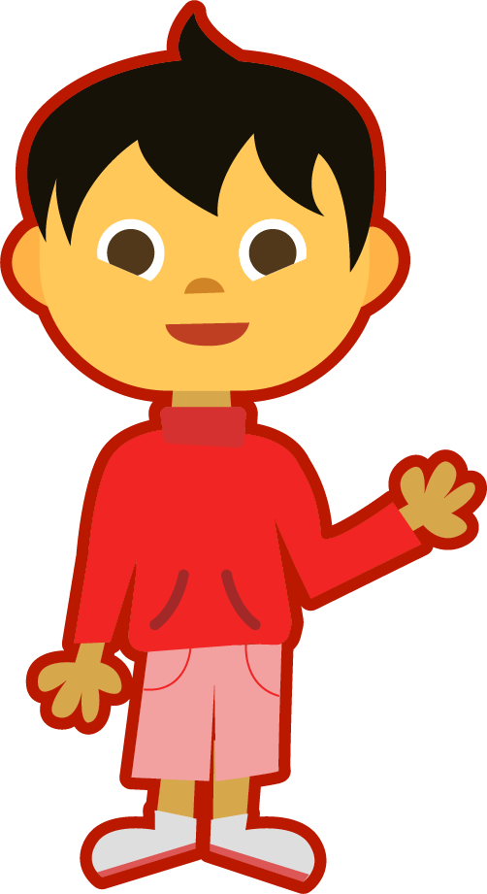
Has this sentence been punctuated correctly?
Ahmed replied kindly “Of course I’ll help you.”
Ahmed replied kindly, “Of course I’ll help you.”
This isn’t correct. There needs to be a comma before the speech punctuation.

Slide 18
Has this sentence been punctuated correctly?
“No talking during the test,” said the teacher, “or you’ll have to stay in at break.”
This sentence is correct!

Slide 19
Which of these sentences has been punctuated correctly?
“Walk the plank!” Cried the pirate.
“Walk the plank!” cried the pirate.
The pirate cried, “Walk the plank”!
The pirate cried “Walk the plank!”

Slide 20
What’s wrong with this sentence?
“Walk the plank!” Cried the pirate.
This shouldn’t be a capital letter; it’s not the start of a sentence.

Slide 21
What’s wrong with this sentence?
The pirate cried, “Walk the plank”!
The exclamation mark should come before the inverted comma.

Slide 22
What’s wrong with this sentence?
The pirate cried “Walk the plank!”
There needs to be a comma before the speech punctuation.

Slide 23
Which of these sentences have been punctuated correctly?
“I haven’t done my homework,” said Eve.
“I haven’t done my homework.” said Eve.
Eve said, “I haven’t done my homework,”
Eve said, “I haven’t done my homework.”

Slide 24
What’s wrong with this sentence?
“I haven’t done my homework.” said Eve.
This isn’t the end of the sentence so it should be a comma.

Slide 25
What’s wrong with this sentence?
Eve said, “I haven’t done my homework,”
This is the end of the sentence so it should be a full stop.

Slide 26
Where should the punctuation go in this sentence?
inverted commas to show the bits being spoken
capital letter to start the sentence
“
”
S
!
the teacher barked sit down
T
,
comma before the speech punctuation
capital letter to start the speech
exclamation mark before the closing inverted comma

Slide 27
When speech appears in a paragraph, we begin a new line each time a different person speaks.
Ruth turned to Ahmed and said, “Will you help me?”
Ahmed replied kindly, “Of course I’ll help you.”
“No talking during the test,” said the teacher, “or you’ll have to stay in at break.”

Slide 28
We don’t always need a reporting clause if it is clear to the reader who is speaking.
Who is saying the part in red?
Yasmin turned around when she heard a noise.
“I think there’s someone in the next room,” she whispered, moving towards the door.
“I can’t hear anything,” replied Chen impatiently.
“I’m sure I heard the floorboards creak!”
“Don’t be silly,” Chen said, “It’s probably just a mouse.”
“I’m sure I heard the floorboards creak!”

Slide 29
Try to remember all of the rules as you punctuate this paragraph correctly.
Where did you get that? Mum asked as she stared at the handful of money clutched in James’ hands. I earned it James muttered, cleaning cars. Mum eyed James suspiciously as he stared at the floor. Cleaning cars? Don’t lie to me James, you can’t even manage to clean your own room! James became increasingly interested in a stain on the carpet which he rubbed with his toe. I found it said James, his voice barely a whisper, in the Secret Shack. Mum’s jaw dropped open. That derelict hut in the park? Mum asked in horror. James nodded his head, weakly.
It was Ahmed’s fault. He made me go in there.

Slide 30
Try to remember all of the rules as you punctuate this paragraph correctly.
“Where did you get that?” Mum asked as she stared at the handful of money clutched in James’ hands.
“I earned it,” James muttered, “cleaning cars.” Mum eyed James suspiciously as he stared at the floor.
“Cleaning cars? Don’t lie to me James, you can’t even manage to clean your own room!” James became increasingly interested in a stain on the carpet which he rubbed with his toe.
“I found it,” said James, his voice barely a whisper, “in the Secret Shack.” Mum’s jaw dropped open.
“That derelict hut in the park?” Mum asked in horror. James nodded his head, weakly.
“It was Ahmed’s fault. He made me go in there.”

