Slide 1
Rearrange sentences so the adverbial is at the front. Punctuate correctly.
Stage 4 Sentence 2.4 and 2.5
National Curriculum Teaching Point:
Fronted adverbials
Use of commas after fronted adverbials
Key vocabulary: adverb, adverbial phrase, comma

Slide 2

Remember that an adverbial phrase can tell us how, where, when, how much or why. What is the adverbial phrase in this sentence?
Yasmin could see a car coming over the horizon.
Yasmin could see a car coming over the horizon.
Does this adverbial phrase indicate where, when or how?
‘Over the horizon’ shows us where Yasmin could see the car.

Slide 3
Identify the adverbial phrase in this sentence.
I heard the bad news later that day.
I heard the bad news later that day.
Does this adverbial phrase indicate where, when or how?
‘Later that day’ shows us when I heard the bad news.

Slide 4
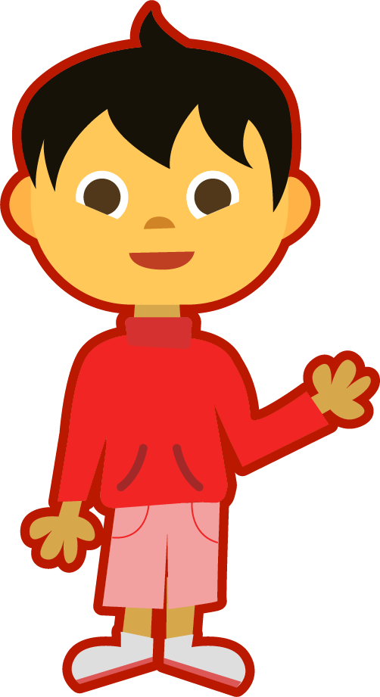
What’s the same and what’s different about these two sentences?
I heard the bad news later that day.
,
Later that day, I heard the bad news.
When the adverbial goes before the main clause, we must separate the two with a comma.
When an adverb goes at the start of a sentence, it is called a fronted adverbial.
An adverbial phrase can go before or after a main clause.

Slide 5

Is this correct?
The flowers opened
in the morning
.

Slide 6

Is this correct?
In the morning
,
the flowers opened
.

Slide 7
Which fronted adverbial best fits this sentence?
________________ the fire engines screeched to a halt outside the burning building.
Over the hill,
As quick as a flash,
As quick as a flash,
Often,

Slide 8
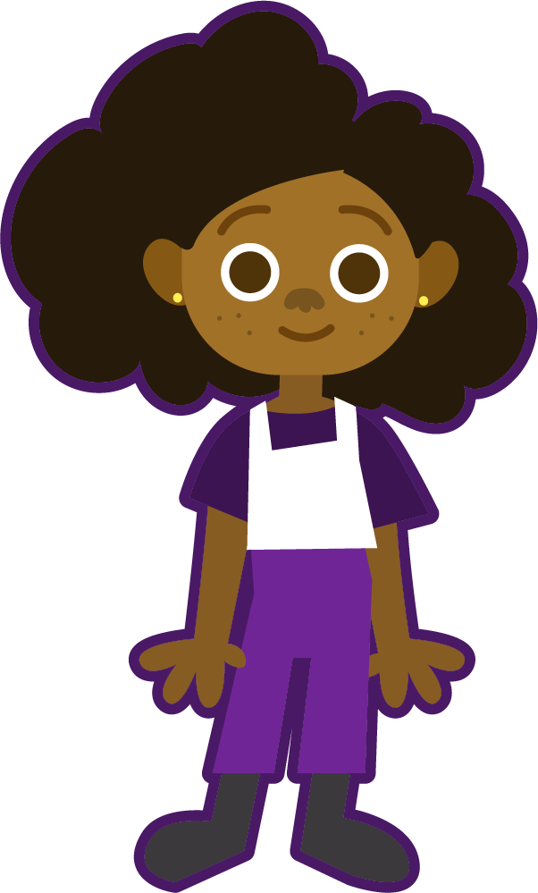
Can you think of your own fronted adverbial that indicates when the fire engines arrived?
Within minutes
,
________________ the fire engines screeched to a halt outside the burning building.
Here’s my example! Did I get it right?
Oops, I forgot the comma! Did you remember yours?

Slide 9
Create your own fronted adverbial for this sentence. Can you spot whether it’s showing how, when or where?
________________ there lurked an old, wizened troll.
Under the bridge,
Here’s my example! Did I get it right this time?

Slide 10
Create your own fronted adverbial for this sentence. Can you spot whether it’s showing how, when or where?
As quickly as possible,
________________ the hare ran from the fox.
Here’s my example!

Slide 11
Chen needs help punctuating his sentence. Which one is correct?
In the morning, the man crawled out of bed.
In the morning the man, crawled out of bed.
In the, morning the man crawled out of bed.

Slide 12
Which of these sentences is correct?
Like a bullet the athlete, shot out of the starting blocks.
Like a bullet the athlete shot out of the starting blocks.
Like a bullet, the athlete shot out of the starting blocks.

Slide 13
Which of these sentences is correct?
Far in the distance, the thunder clouds began to gather.
Far, in the distance the thunder clouds began to gather.
Far, in the distance, the thunder clouds began to gather.

Slide 14
Where should the punctuation go in this sentence?
comma
capital letter
in the middle of the night the boy woke with a start
I
,
.
full stop

Slide 15
Where should the punctuation go in this sentence?
capital letter
T
twice a day the girl had to take her medicine
,
.
comma
full stop

Slide 16
Where should the punctuation go in this sentence?
capital letter
J
jamal crept downstairs early in the morning
.
The adverbial phrase is after the main clause so no need for a comma!
full stop

