Slide 1
Talk 4 Writing
Parent Workshop

Slide 2
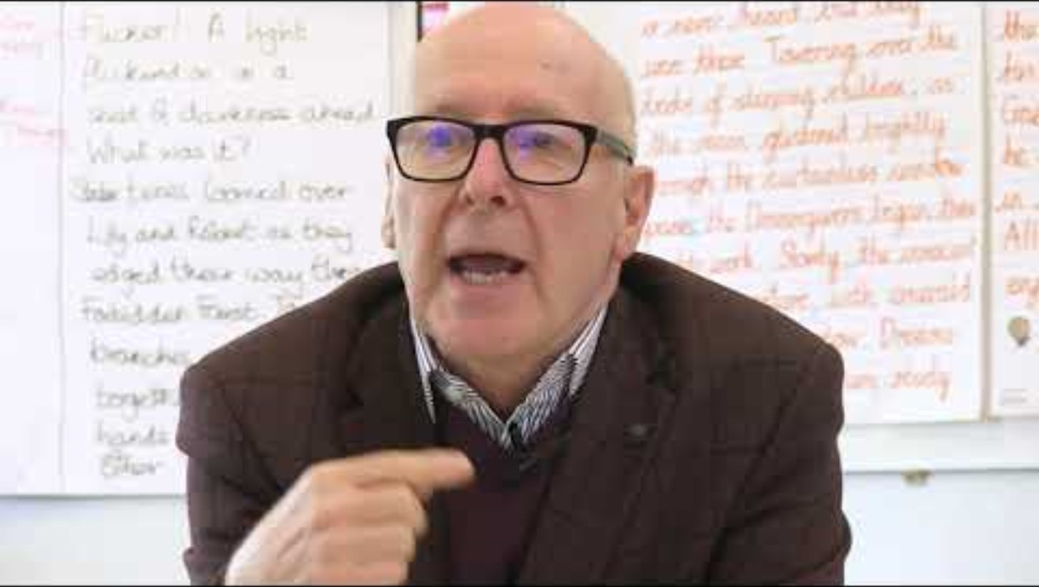
What is Talk 4 Writing?

Slide 3
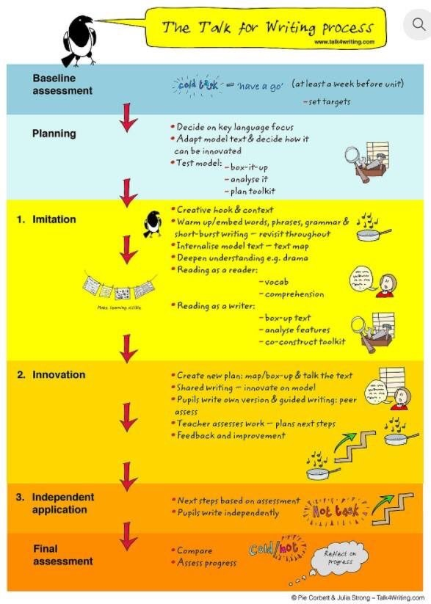
The T4W Process
Moving through these different stages over 4 weeks for fiction units and 2 or 3 weeks for non-fiction units

Slide 4
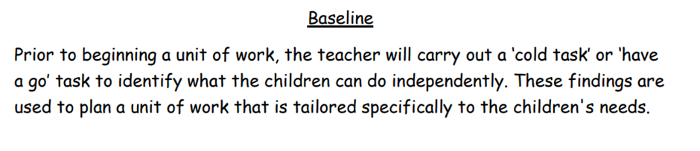
Baseline

Slide 5
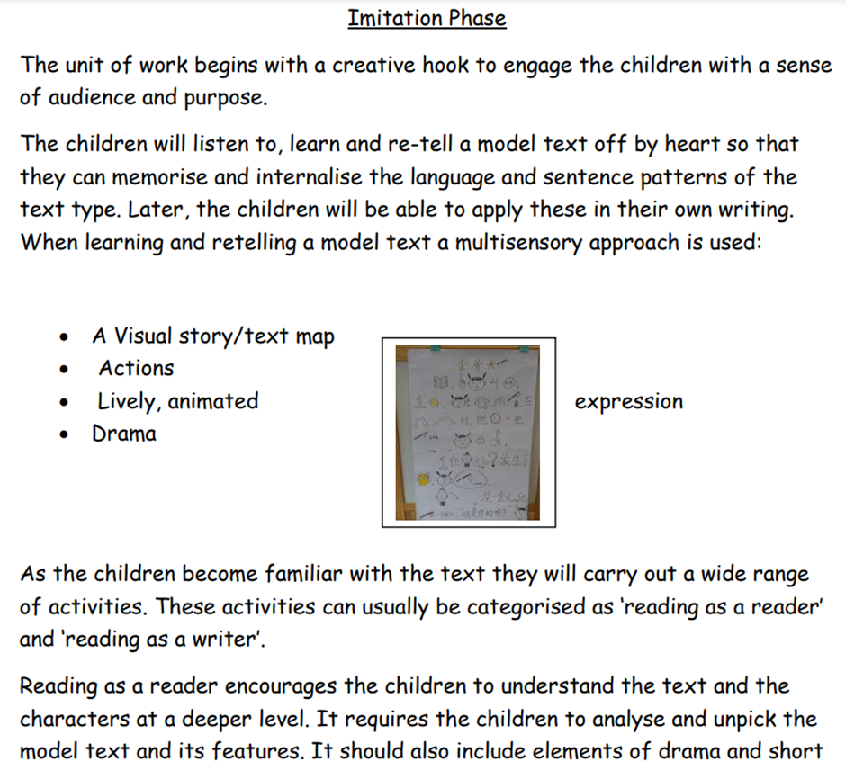
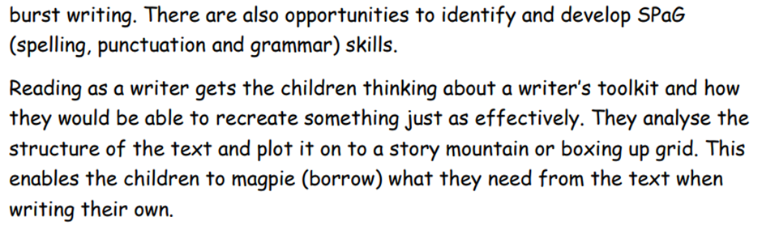
Baseline

Slide 6
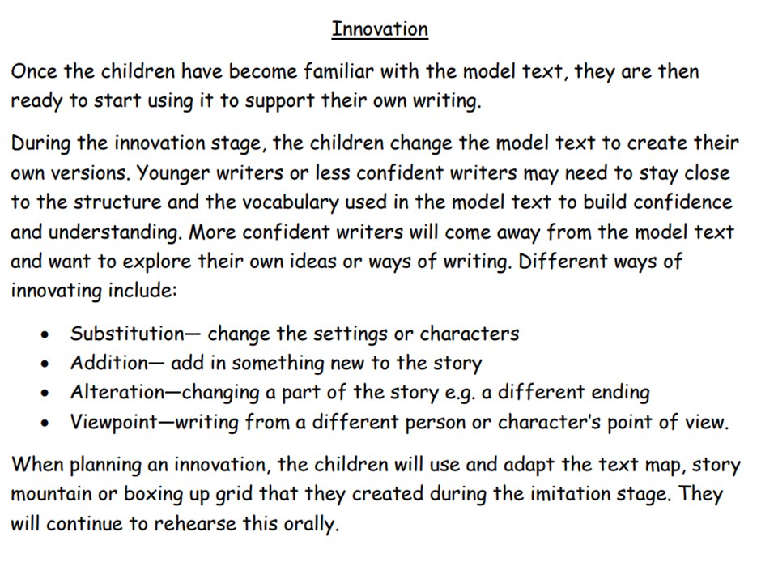
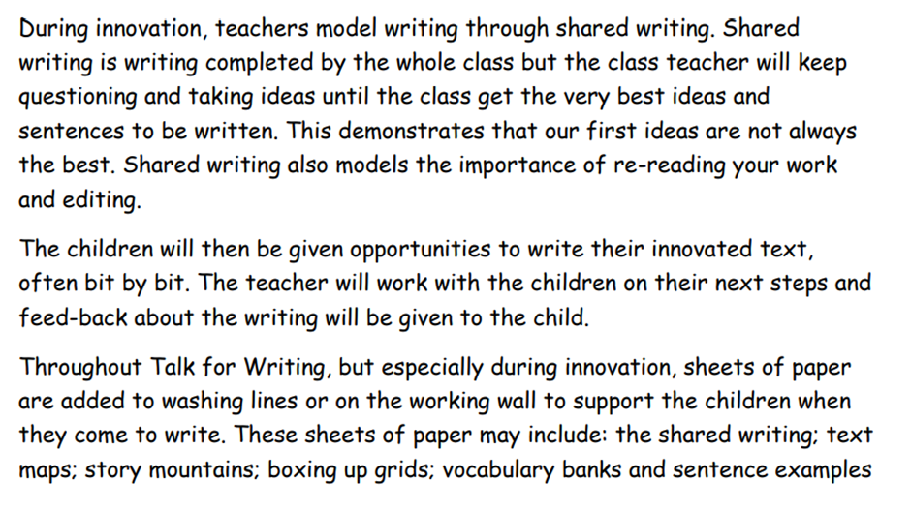
Baseline

Slide 7
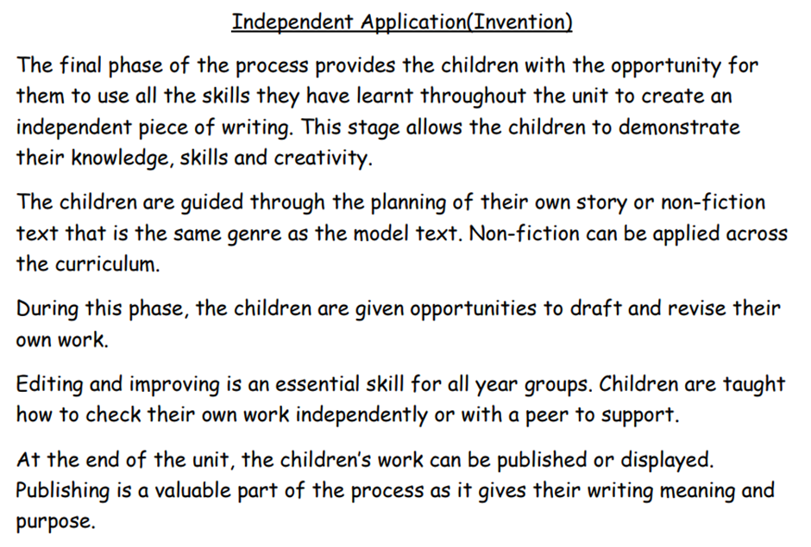
Baseline

Slide 8
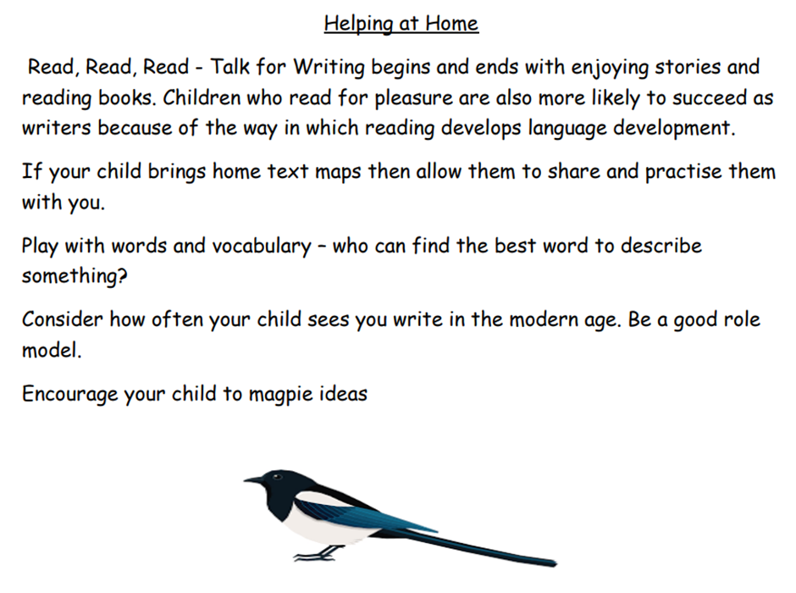
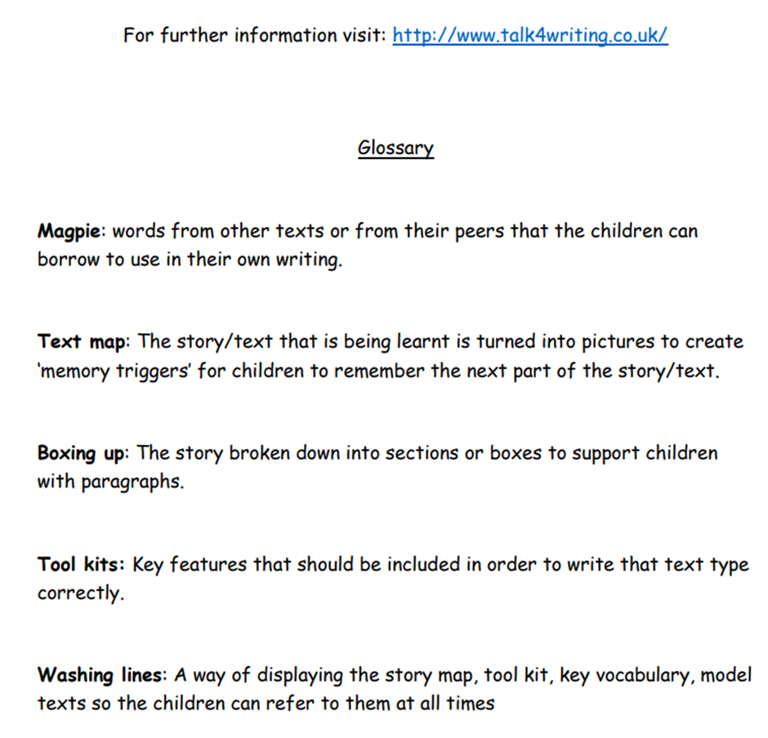
Let's See Year 1 in Action!

Slide 9
Time to have a go
Model texts – can you learn a paragraph off by heart? Use icons and actions to help you!
SBW – have a go at an 'I am' or 'Spine' poem!
Innovation – can you innovate a paragraph?
Have a look at some of the fantastic examples from the children's books!
Model texts available for: Reception, Y2, Y3 and Y6

