Slide 1

Reading at
Great Missenden School

Slide 2
Presentation aims:
Reading structure at GM
Reading spine
Reading fluency
VIPERS reading strategies and skills – KS1 and KS2
How to support with reading at home
Reading recommendations - useful websites

Slide 3
At Great Missenden, we are readers.
We believe in developing a culture that encourages a desire and love for reading whilst providing a diverse range of texts for all pupils to access.
We believe that reading plays a key role in developing the ability to understand the experiences of others, consequently fostering children's language skills, social acceptance, and cultural sensitivity.
We aim for all of our children to leave primary school with the ability to read confidently and enjoy a wide range of texts and become lifelong readers.
Our curriculum:

Slide 4
Reading Structure
Phonics in EYFS, KS1 and rapid catch up phonics in KS2; regular reading & interventions as necessary
Guided Reading sessions in KS2:
Monday: Reading for pleasure/ book talk session
Tuesday, Wednesday and Thursday: Whole Class Guided Reading using a variety of extracts from the Ashley Booth reading spine and focusing on developing reading comprehension skills through the use of VIPERS
Friday: Class novel (linked to wider curriculum reading)

Slide 5
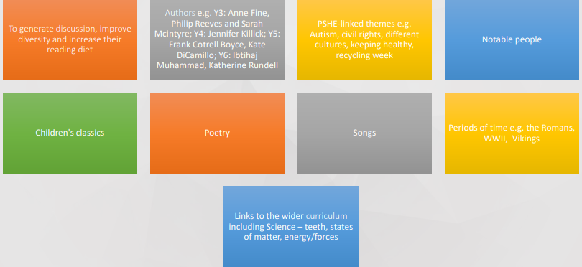
Reading Spine in
Guided Reading lessons

Slide 6

Reading Fluency
Collins Big Cat book band scheme to 'free readers’
Books chosen by children / assigned to them if necessary
Fluency assessments 3 x a year as a minimum – include speed, accuracy and comprehension
Reading Records to communicate book bands, record & track reading
Reading every day at home in addition to what they also do in school

Slide 7
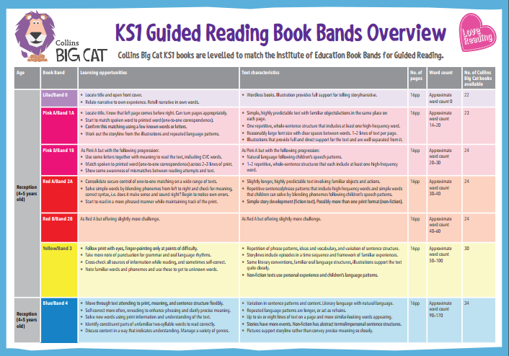

Slide 8
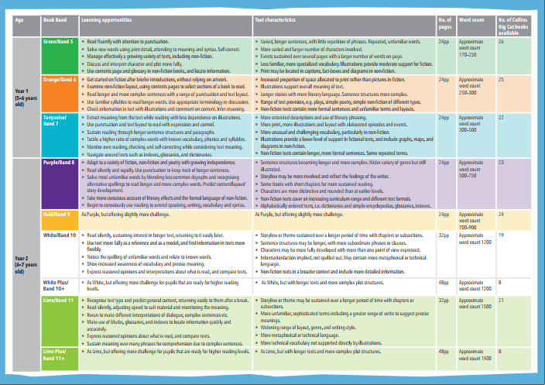

Slide 9
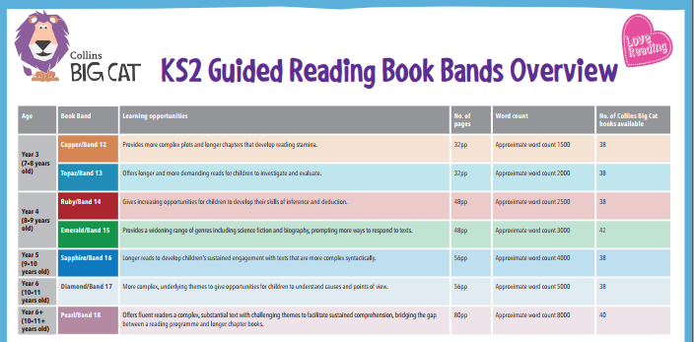

Slide 10
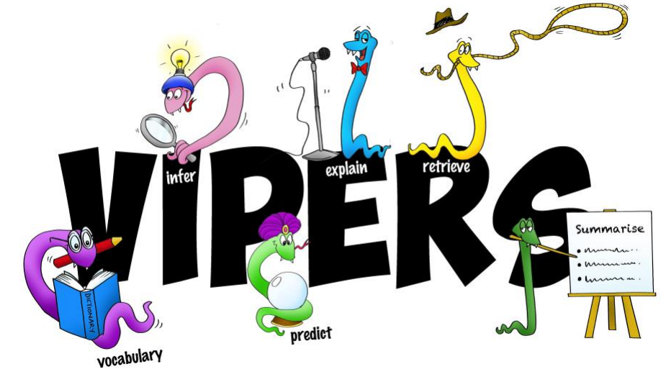
Reading Skills

Slide 11
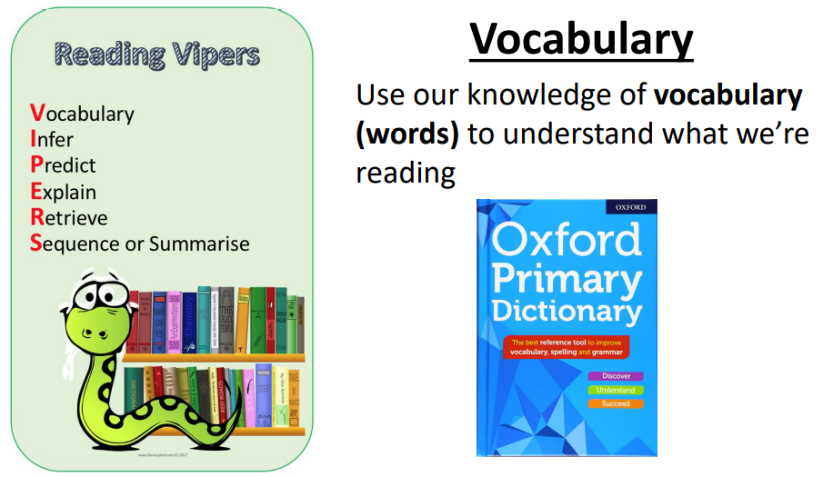

Slide 12
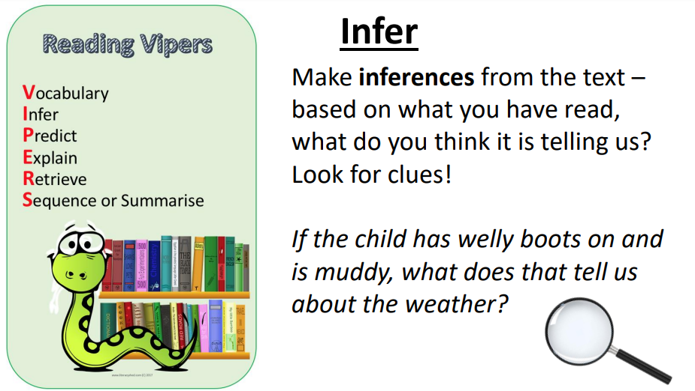

Slide 13
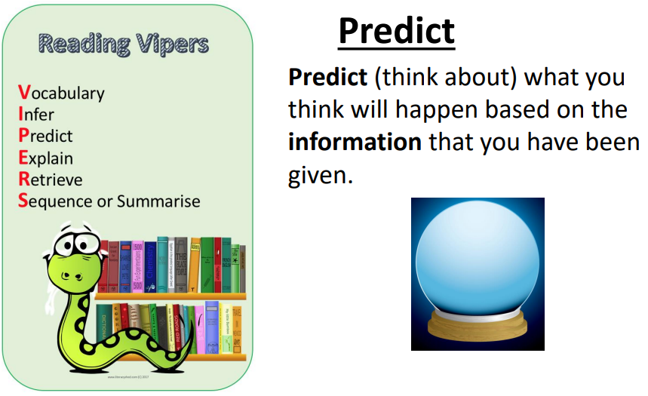

Slide 14
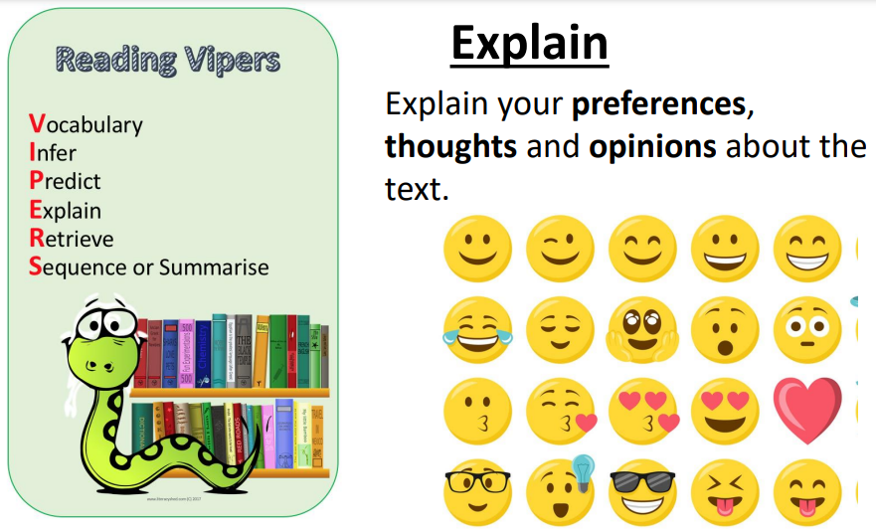

Slide 15
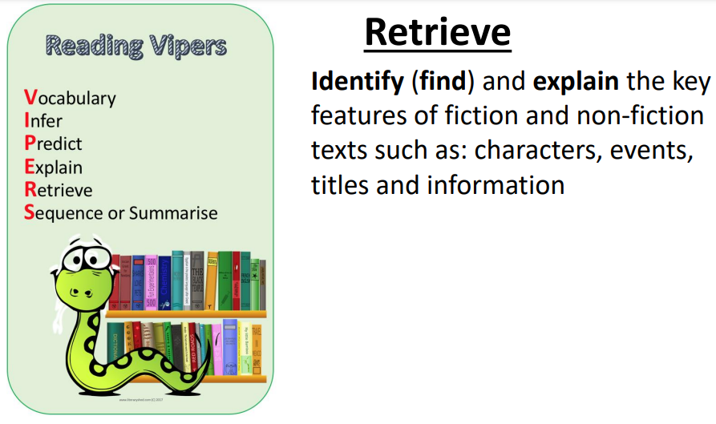

Slide 16
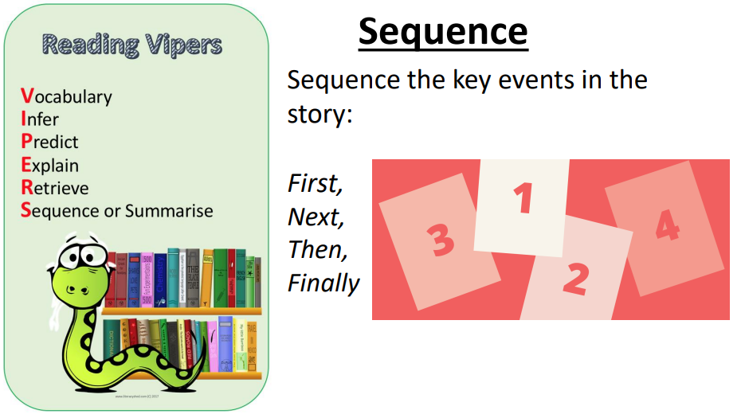

Slide 17
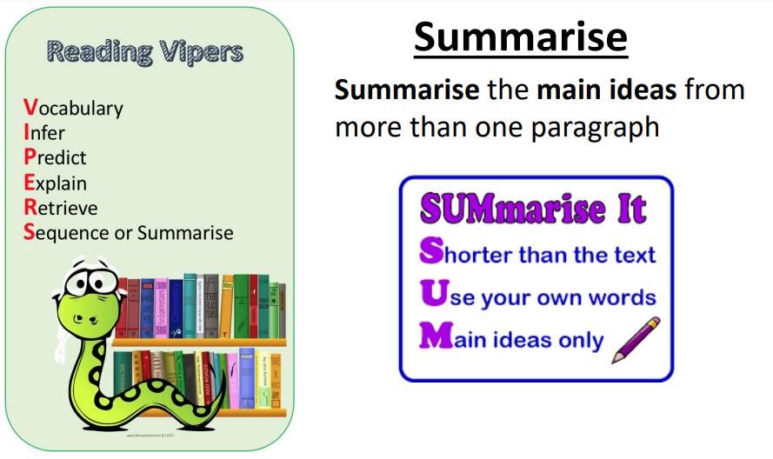

Slide 18
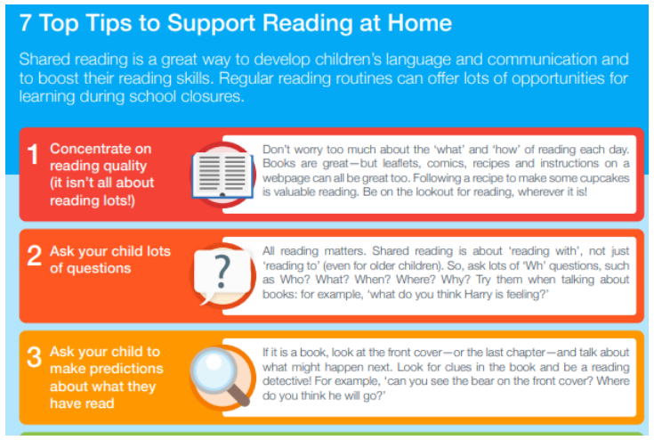
Supporting at home

Slide 19
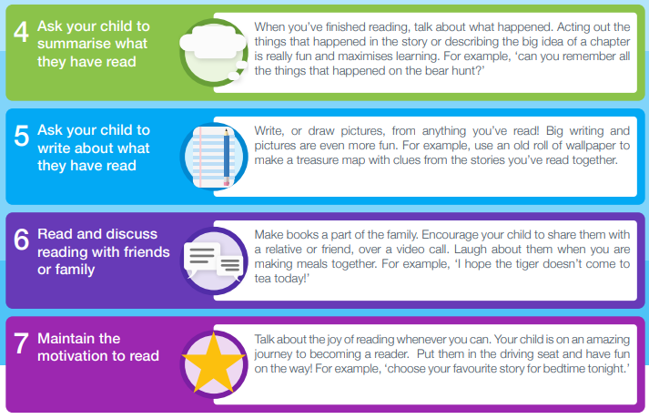

Slide 20
Read regularly with your child
Let them see you as a 'reader’
Discuss your likes and dislikes of books/genres/author
Encourage reading to be fun
Visit the library or swap books with other families – this also encourages book talk
Echo read parts (you read it aloud how you would expect it to be read with intonation, expression or a different voice and they repeat this back to you)
Use the VIPERS acronym with question stems (available on the school website) to support your questioning of books your child is reading
Record reading and comments in their Reading Record or on Boom Reader
Talk to them about how much you have read today – road signs, emails, texts, articles online – anything!

Slide 21
Reading Recommendations
The Book Trust website:
https://www.booktrust.org.uk/books-and-reading/our-recommendations/
Love Reading 4 Kids (free extracts)
https://www.lovereading4kids.co.uk/browse-by-age
The Reader Teacher
https://www.thereaderteacher.com/
Books for Topics
https://www.booksfortopics.com
The School Reading List
https://schoolreadinglist.co.uk/resources/childrens-literature-awards/

