Slide 1




Review Lesson Plan
(EYFS-KS1)

Slide 2

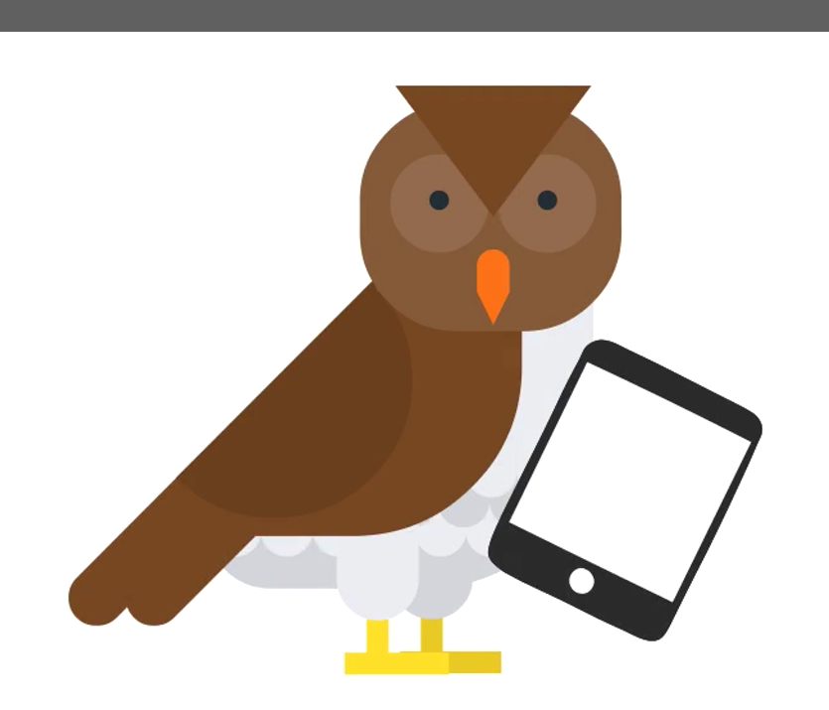
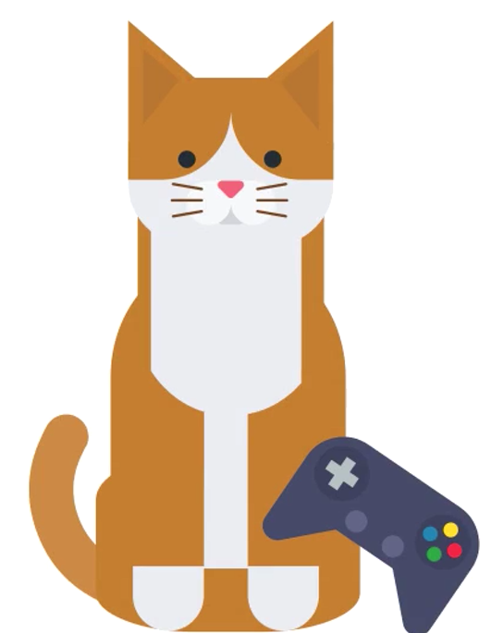
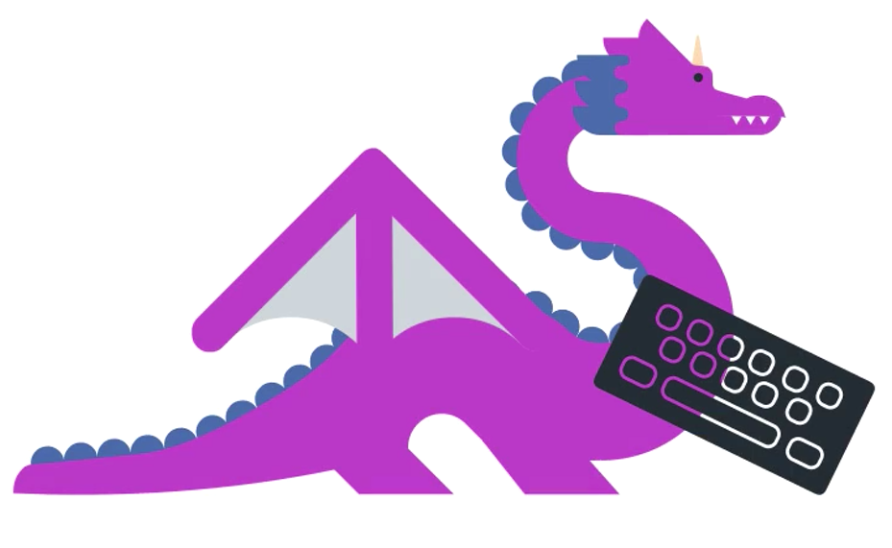
Who did you meet in Internet Land?
Notes:
Who did you meet in Internet Land?
Dom Dragon
Callie Cat
Ola Owl

Slide 3

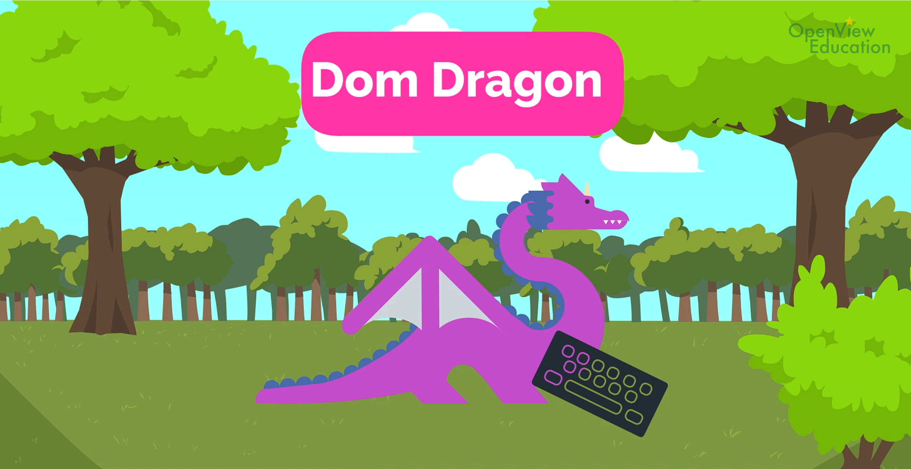
What did we learn from Dom Dragon?
Notes:
What did we learn from Dom Dragon?
Dom Dragon showed us that it’s important to be kind online and use kind words.

Slide 4
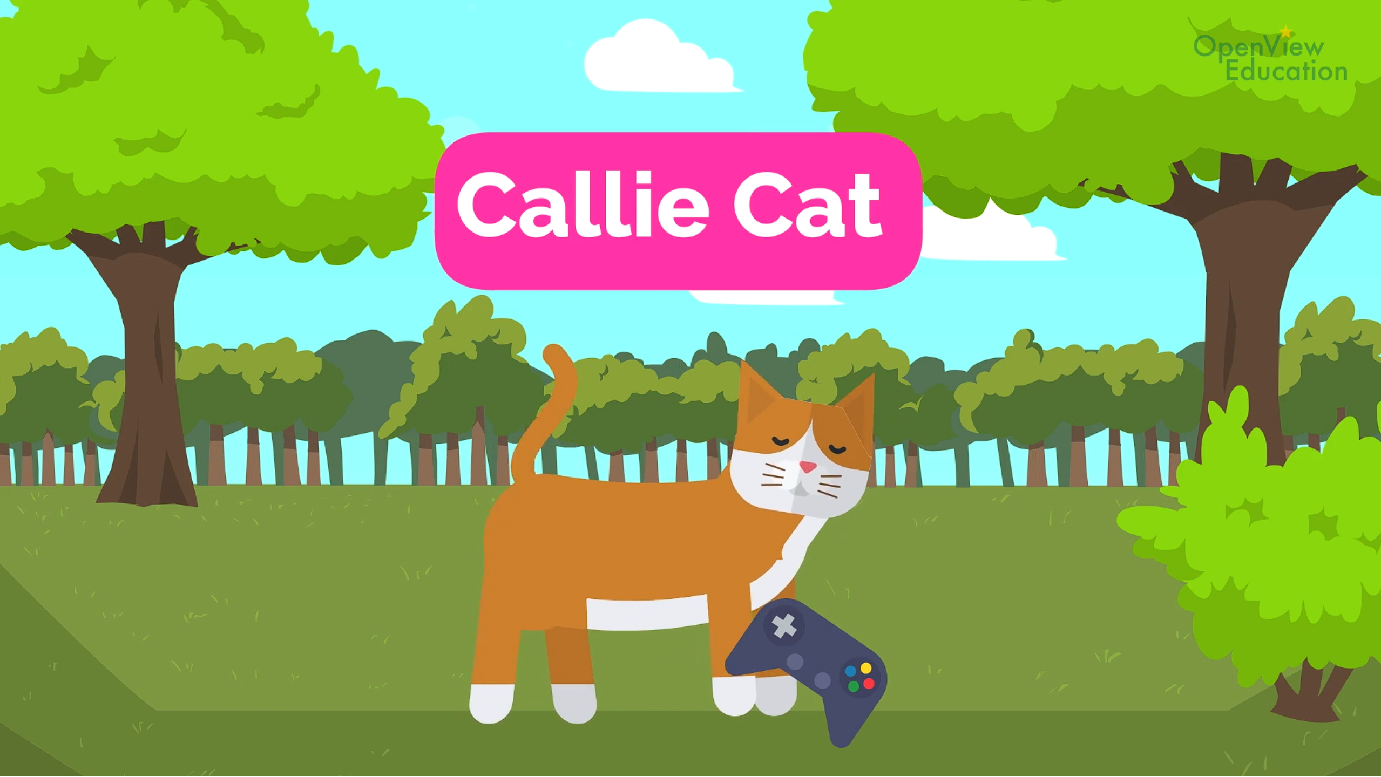
What did we learn from Callie Cat?
What did we learn from Cali Cat?
Notes:
What did we learn from Callie Cat?
Callie Cat showed us what we need to keep safe and private on the internet.
What do we need to keep safe and private on the internet?
Our full name.
Where we live.
Our school.
Our passwords.
Our birthday.

Slide 5
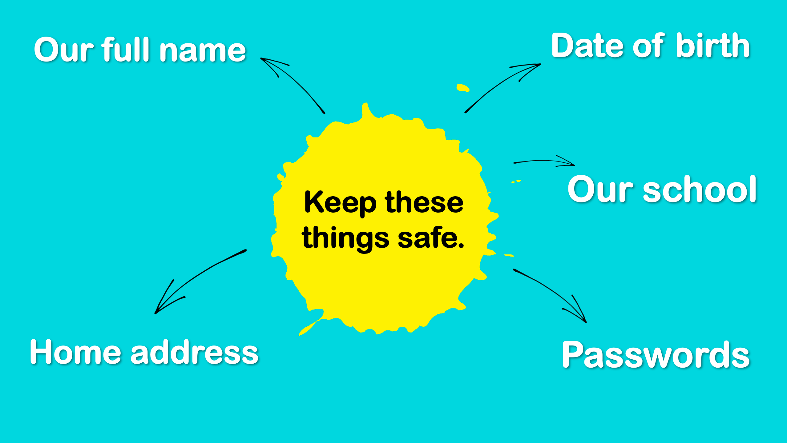

Slide 6
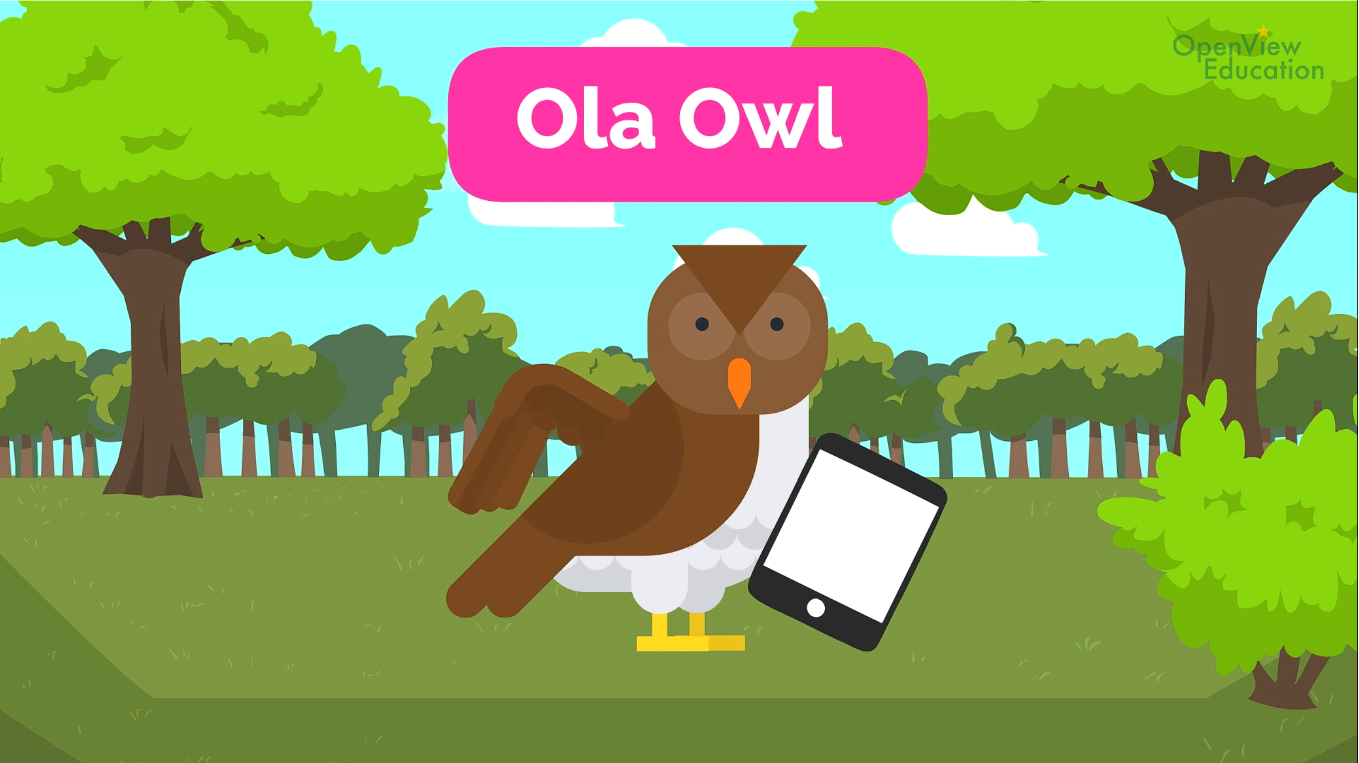
What did we learn from Ola Owl?
Notes:
What did we learn from Ola Owl?
Ola Owl showed us that we can tell a trusted adult if we ever feel worried about anything that happens online.

Slide 7
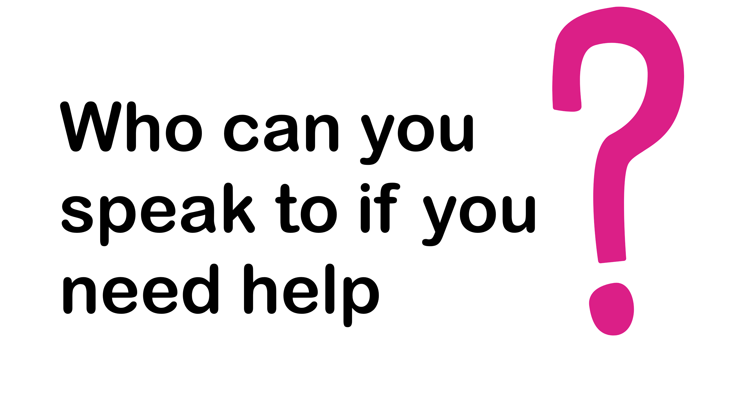
Notes:
Who could you speak to if you felt worried about something that happened online?
Parents, Carers, teachers at school.

Slide 8

Let’s cast the Internet Safety Spell!
Typing mean things
Makes people sad
Use kind words
And they’ll feel glad!
Are you being asked
Things about you?
Don’t share them!
It’s not safe if you do!
Use the Internet
Enjoy yourself!
Feeling worried?
Ask for help!
Notes:
During the workshop your students will have taken part in casting an Internet Safety Spell. You can display the words for the spell on the screen and get your students to repeat back the words back. See if you can include the actions that were used in the workshop too:
Typing mean things
Makes people sad
Use kind words
And they’ll feel glad!
Are you being asked
Things about you?
Don’t share them!
It’s not safe if you do!
Use the Internet
Enjoy yourself!
Feeling worried?
Ask for help!

Slide 9

Now create your poster!

Slide 10
We are Internet Safety Wizards!
Be kind online.
Tell someone.
Keep it safe.
Notes:
Your students can now create an Internet Safety Wizards poster. This can include the title of ‘We are Internet Safety Wizards’, all of the characters that they met during the Workshop and a short sentence about what they learnt.
Display this slide on the screen and your students can copy it to create their poster.
Once your students have created their E-Safety Wizards Poster, these can be used to create an Internet Safety Wall Display for your classroom.

Slide 11

Well done!

