Slide 1

Internet Safety Lesson
It’s Your Choice! (Rec – Year 3)

Slide 2

We All Have Choices!
What is a good online choice?

Slide 3
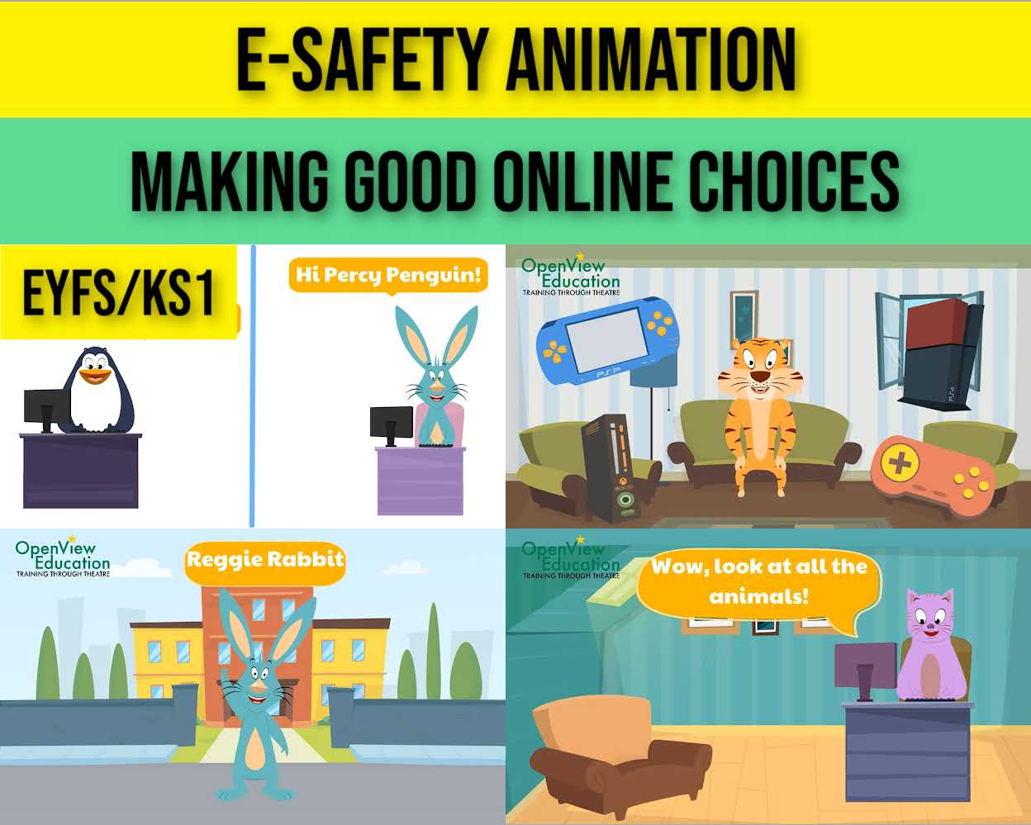
Now Watch ‘Making Good Online Choices’!
Click here to watch!

Slide 4

My Online Advice
MY Online Advice.
Dear….
From…
Now write a letter of your online advice.

Slide 5
Well done!

