Slide 1

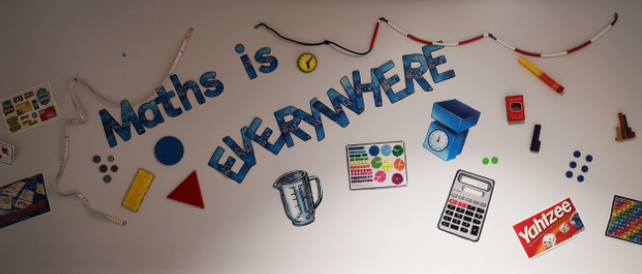
Maths at Great Missenden
Parent Workshop – April 2023

Slide 2
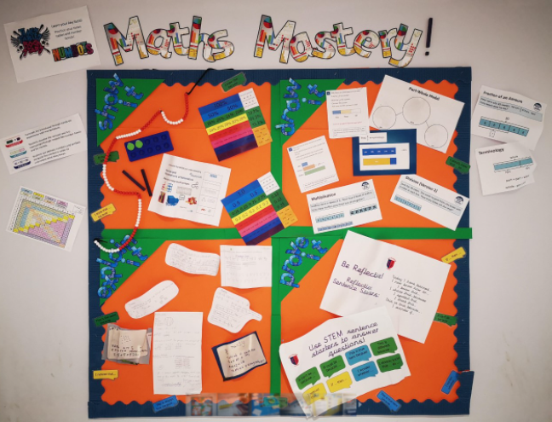
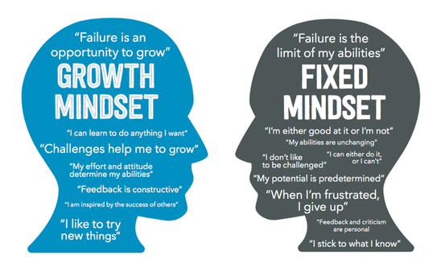
Presentation aims:
How is maths taught at GM?
What does maths look like at GM?
How can I support my child at home with maths?
Lots of time for trying maths questions yourselves!

Slide 3
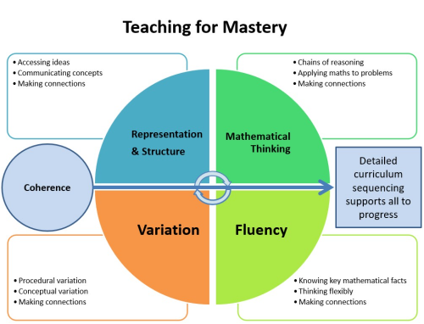
How is maths taught at GM?
Maths Mastery
Mathematics teaching for mastery assumes everyone can learn and enjoy mathematics!
Mastering maths means pupils of all ages acquiring a deep, long-term, secure and adaptable understanding of the subject. The phrase ‘teaching for mastery’ describes the elements of classroom practice and school organisation that combine to give pupils the best chances of mastering maths. Achieving mastery means acquiring a solid enough understanding of the maths that’s been taught to enable pupils to move on to more advanced material.
The Five Big Ideas underpin teaching for mastery:

Slide 4
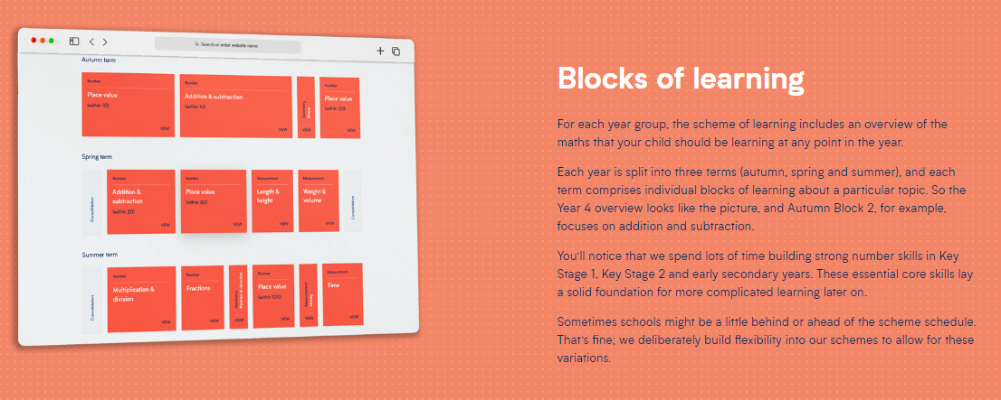
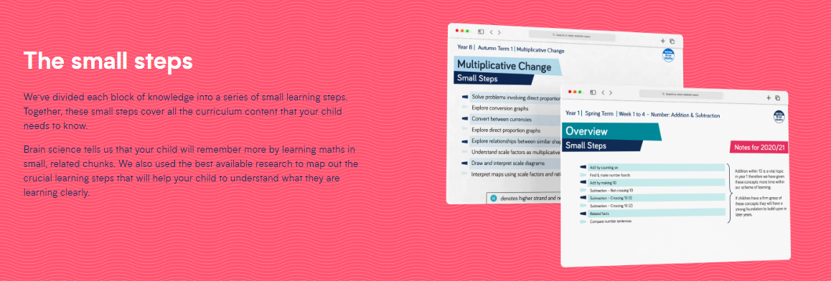


How is maths taught at GM?
White Rose Curriculum
We follow the ‘White Rose’ maths curriculum. The curriculum is split into ‘blocks’ and then further into ‘small steps’.

Slide 5
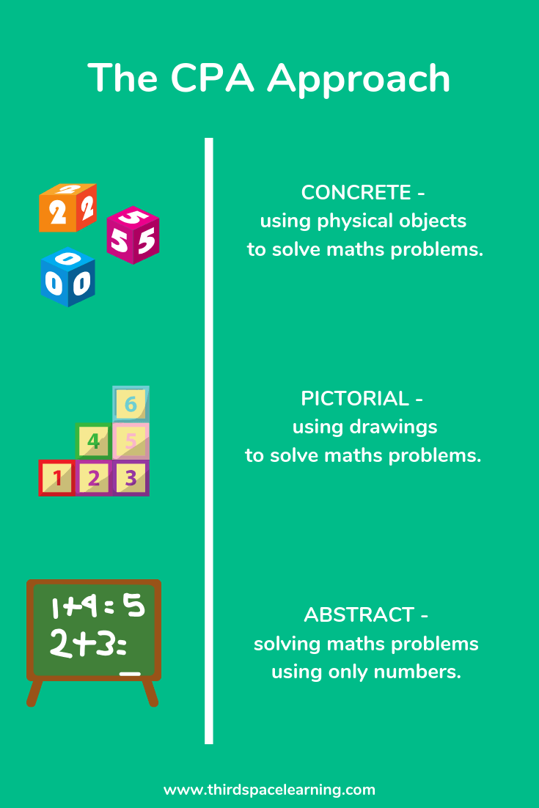
What does maths look like at GM?
Concrete-Pictorial-Abstract
The White Rose curriculum is designed to make maths visible through physical objects and pictorial representations of a concept. Children will build their understanding of a concept through experimenting with physical resources, then learning how to draw or represent the concept visually and finally moving on to use abstract methods.
During a block or sequence of small steps, children will be able to move from concrete, to pictorial, to abstract as their understanding develops and deepens. Often, the concrete and pictorial will be used alongside the abstract method to ‘make the maths visible’.

Slide 6
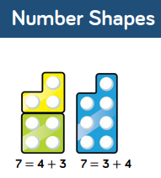
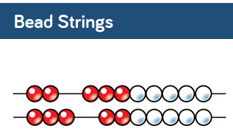
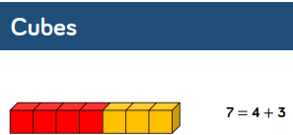
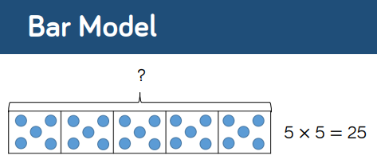
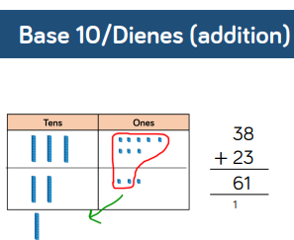
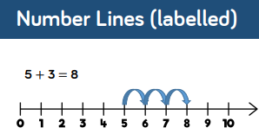

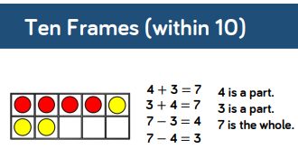
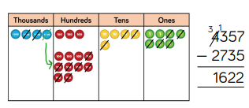
What does maths look like at GM?
Concrete-Pictorial-Abstract
Some of the most common objects and pictorial representations we use are:

Slide 7
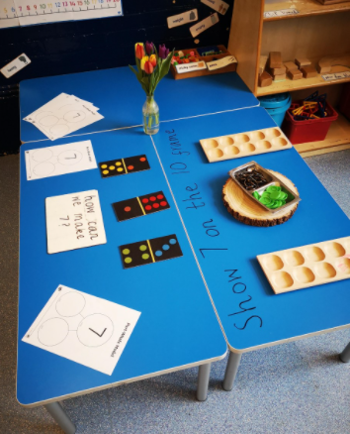
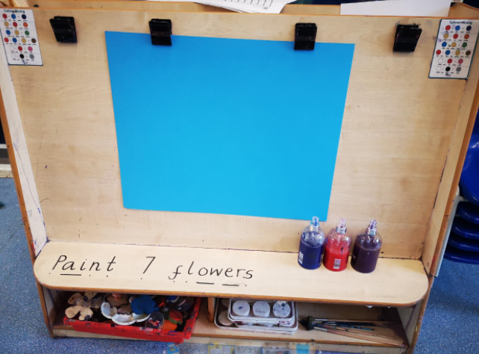
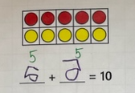
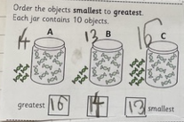
What does maths look like at GM?
Lessons
A typical lesson might look like:
Early Years – lots of practical activities based on number using a variety of representations, a focus on a specific number for the week
KS1 – fluency, reasoning and problem solving tasks based on a ‘small step’ with some guided and group activities as well as some independent tasks.
KS2 – fluency, reasoning and problem solving based on a ‘small step’ with some group and partnered work as well as independent tasks.

Slide 8
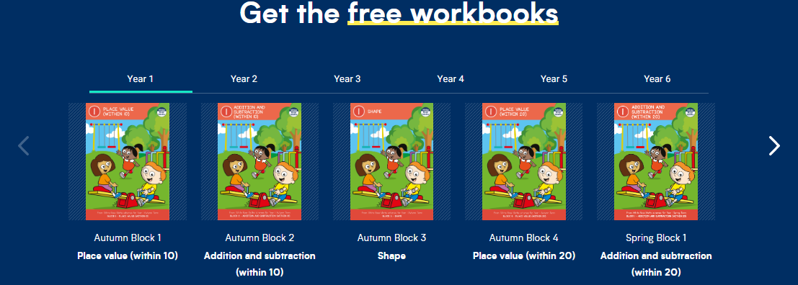
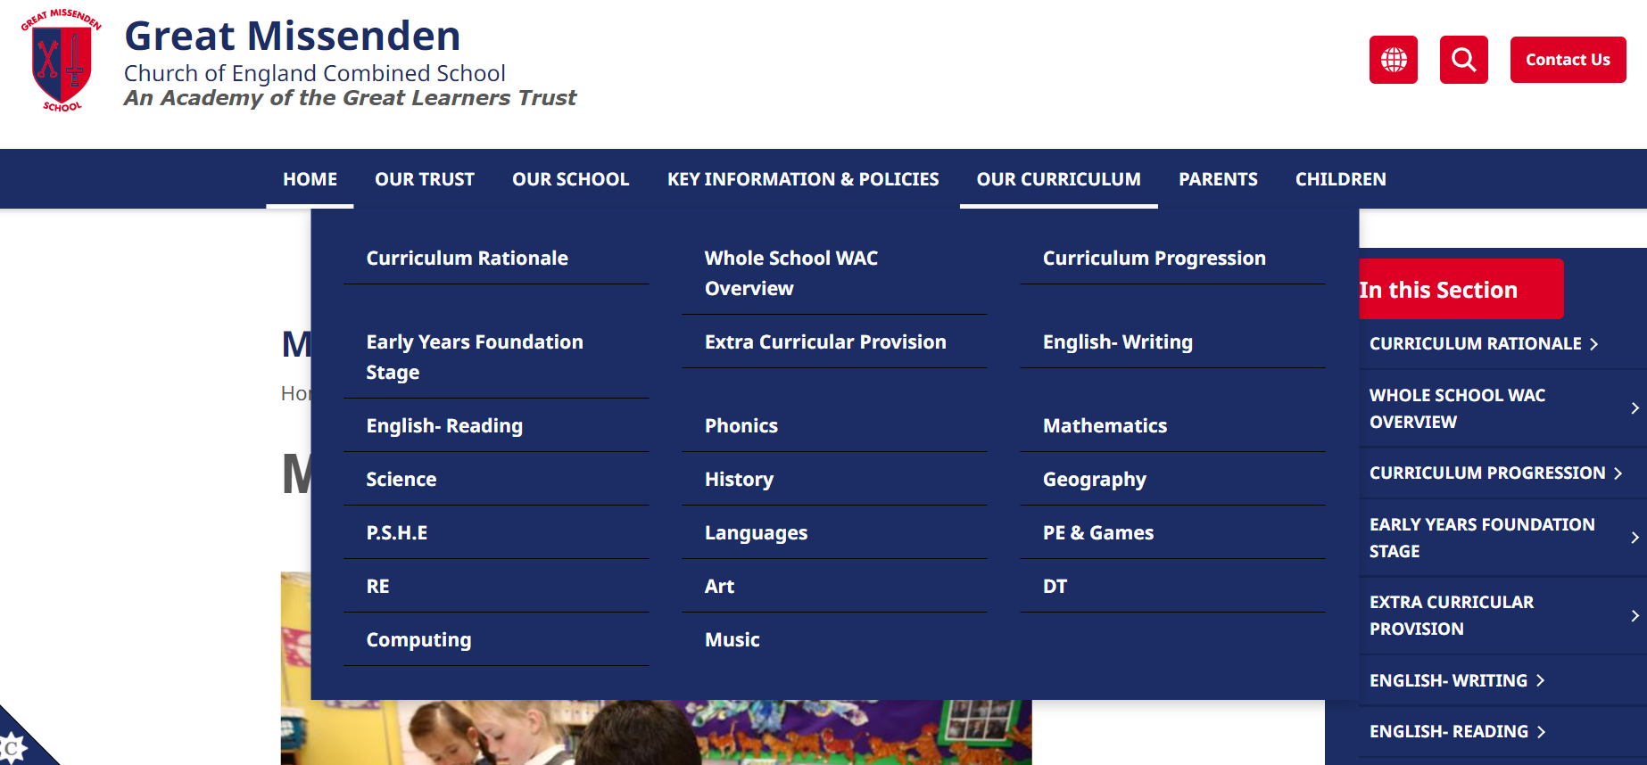




How can I support my child at home with maths?
White Rose Workbooks, Mathletics, TTR and Numbots
White Rose have created workbooks which are aligned with our ‘blocks’. These are free to download and print and are helpful if your child needs to recap concepts further.
https://whiterosemaths.com/parent-resources
Your child will have mathletics / TTR / numbots tasks to complete for their homework. You can apply any of our ‘concrete, pictorial and abstract’ methods to support your child’s understanding with these activities. We are going to try using some of these approaches now and all of them can be found on our website.

Slide 9
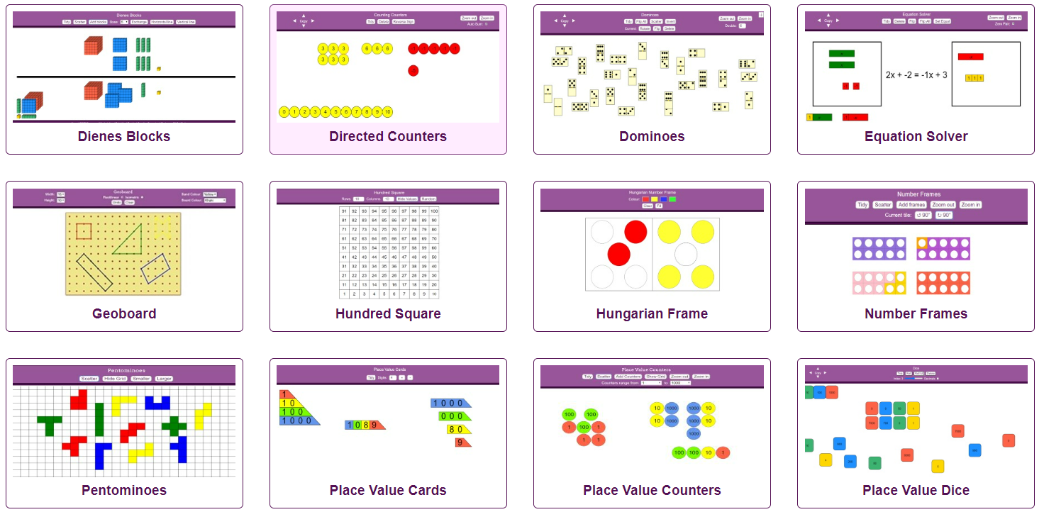
How can I support my child at home with maths?
Using our CPA approach!
There are stations set up around the room with ‘manipulatives’ and examples for you to try out so you can see how children learn the 4 operations in different year groups.
No maths manipulatives at home? No stress! Just use the following website:
https://mathsbot.com/manipulativeMenu

