Slide 1

Phonics at Great Missenden

Slide 2
Phonics and Early Reading
Welcome to our meeting
Part 1 – information about how we teach phonics
Part 2 – information about how we teach reading

Slide 3




How many times have you already read today?
Notes:
Just think about how many times you have already read things today. It really is a vital skill.

Slide 4

New DFE Guidance for Early Reading and Phonics
The journey to independent reading and writing begins with Phonics
littlewandlelettersandsounds.org.uk
Why Little Wandle?
Excellent training for all staff to ensure consistency,
Every aspect of phonics and reading included in a detailed, thorough and
systematic approach,
Engaging resources without distracting from the learning,
Comprehensive system for identifying and supporting children requiring
extra help and useful support for parents.
Notes:
Government changes mean a change (for the better) in how we teach phonics and reading at school - make sure there is consistency throughout
Early reading is the stage where children are learning to become fluent readers through the use of phonics

Slide 5
Terminology
Children are taught this language from the 2nd week Reception.
Would you be confident with explaining what each one means?
Phoneme
Split vowel digraph
Grapheme
Blend
Digraph
Segment
Trigraph
Notes:
Explain what each word means – use our glossary to help: https://www.littlewandlelettersandsounds.org.uk/resources/my-letters-and-sounds/getting-started/

Slide 6
Now your turn…
Have a go at segmenting some of these words..

Slide 7
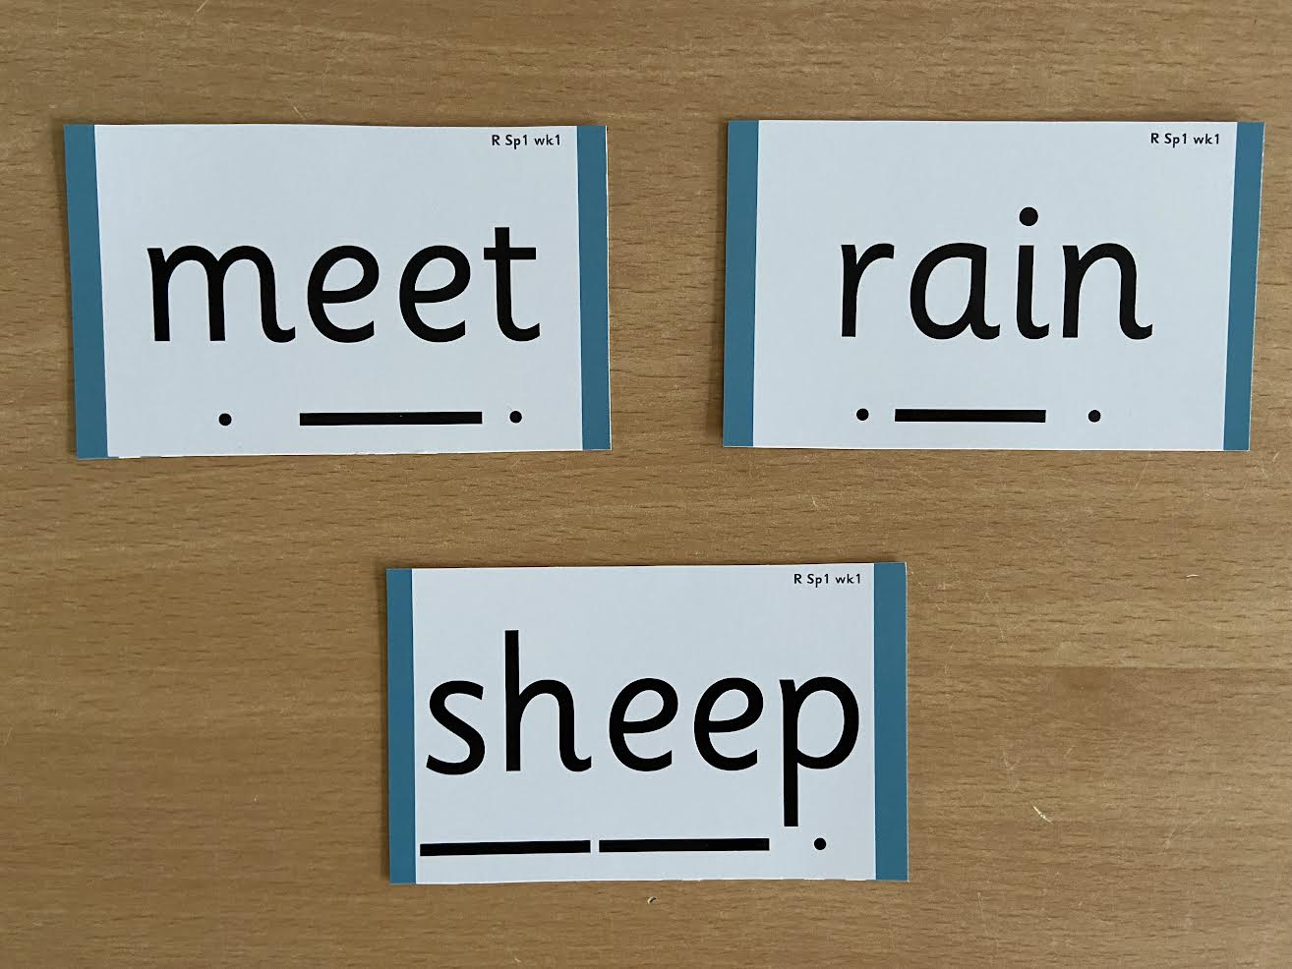
Notes:
Digraphs have a zip to sound talk and blend

Slide 8
How we teach phonics
Daily short sessions
Specific order of teaching
Synthetic phonics – this is where words are broken down into the smallest units of phonemes.
Repeated practice
MUST
Pronunciation – pure sounds – FLASH CARDS
All staff trained in the scheme
Revisit previously taught phonemes at the start of each lesson

Slide 9
Pronunciation
These three videos show you how to pronounce the sounds. Notice how the children don’t add an ‘uh’ sound at the end, so they say: ‘t’ not ‘tuh’. Use the downloadable information to help your child remember how to write their letters and say their sounds.
Videos
https://www.littlewandlelettersandsounds.org.uk/resources/for-parents/

Slide 10
Pre-School
Foundation for phonics
The most important aspects of Foundations for Phonics to develop in the pre-school are:
• sharing high-quality stories and poems with children
• learning a range of nursery rhymes and action rhymes
• activities that develop focused listening and attention, including oral blending.
• attention to high-quality language with children, learning lots of new vocabulary.
The above provision will ensure children are in the best possible place to begin Phase 2 at the very start of Reception. To enable children to have a strong start with their phonics learning, they must start Phase 2 by the second week of their Reception year.

Slide 11
How parents can support at home
‘Play with sounds’ • ‘Bertha the bus goes to the zoo’ • ‘Name play’ • ‘Voice sounds’ • ‘What’s in the box?’
Use a wide range of nursery rhymes and action rhymes. • Repeat these often, so that children learn the words and actions for themselves. • Use actions and clapping. • Use different voices and sound effects.
talking about and around the book, rather than just focusing on the text
pause reading – where the practitioner pauses and encourages the children to talk
use of props or objects – particularly effective for children with low levels of language

Slide 12
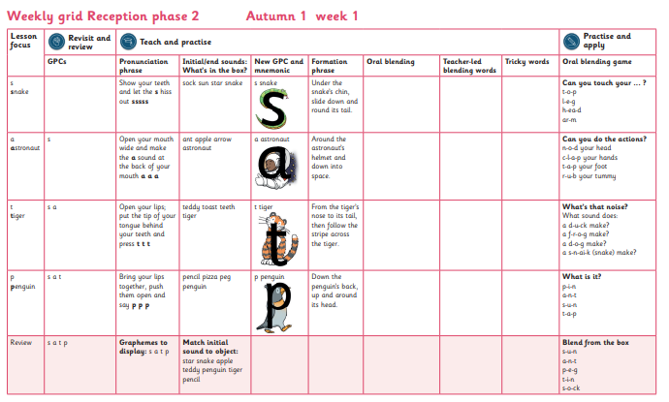
Reception
Notes:
We usually teach four new sounds a week and have a review lesson on a Friday. You will get a list of the sounds that we are learning to have at home. This will help you with formation and pronunciation
We will work our way through the whole Little Wandle Programme until your child can read fluently.

Slide 13
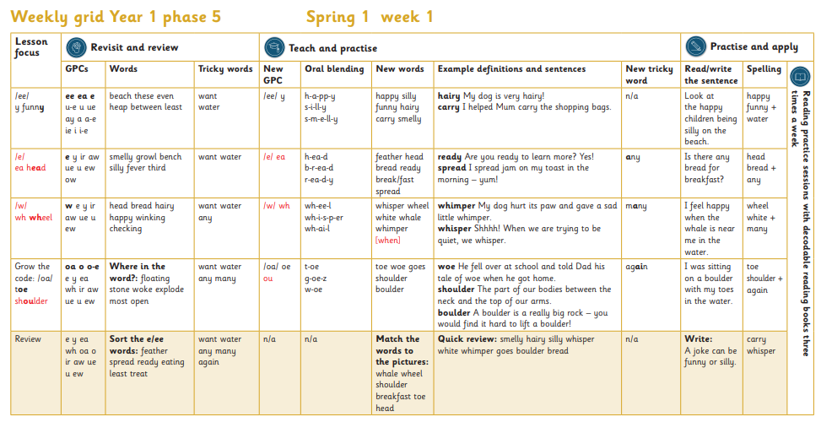
Year One

Slide 14
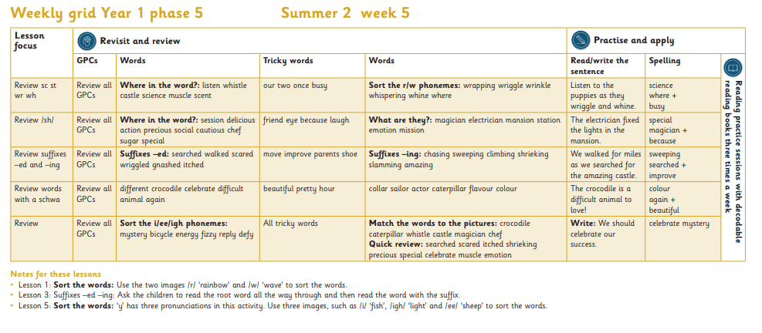
Year Two

Slide 15
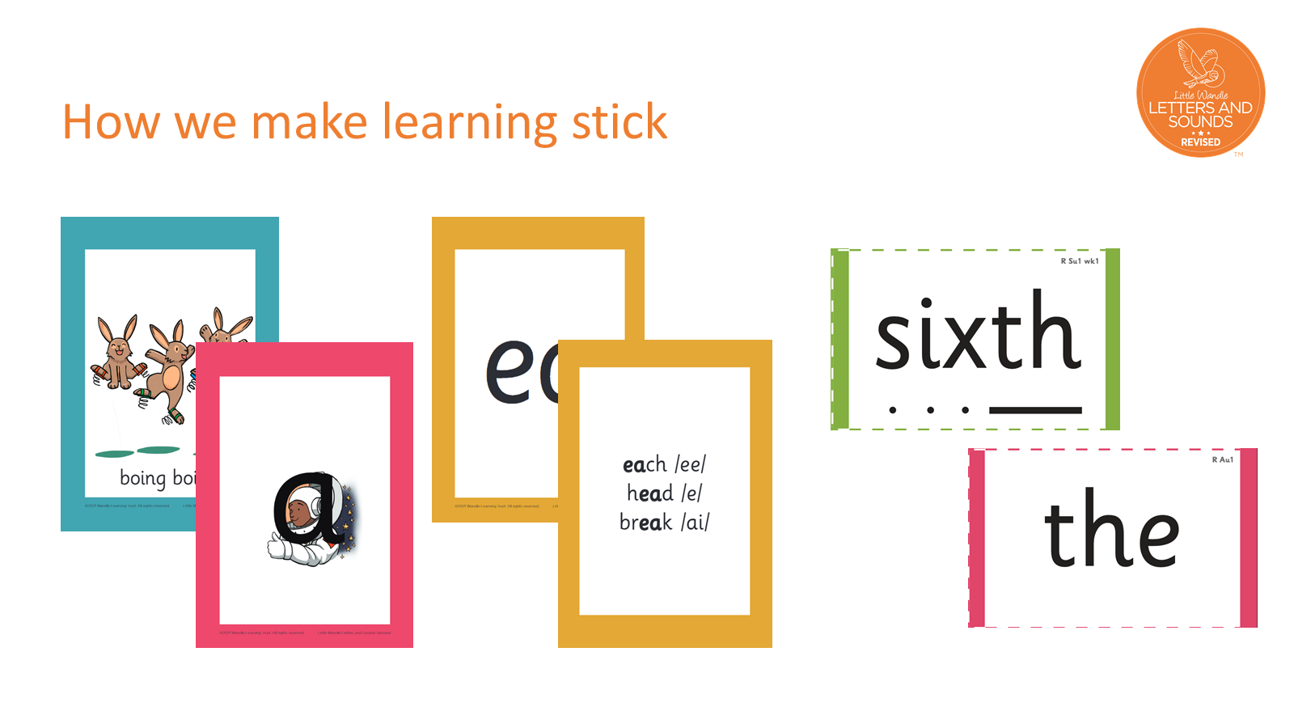
Notes:
There are specific resources for the Little Wandle Programme which the children will be very familiar with. Each sound that we teach to begin with has either a mnemonic (like the astronaut that you can see here) or a phrase like boing-boing for ‘oi’. This helps the children recognise and remember the graphemes. Every time we teach a new sound, we also read words during the phonics lesson that contain that new sound so that the children practise what they have learned. We then go on to reading a sentence containing some of those words. We have displays in the classroom and on the tables to support the children throughout the day.

Slide 16
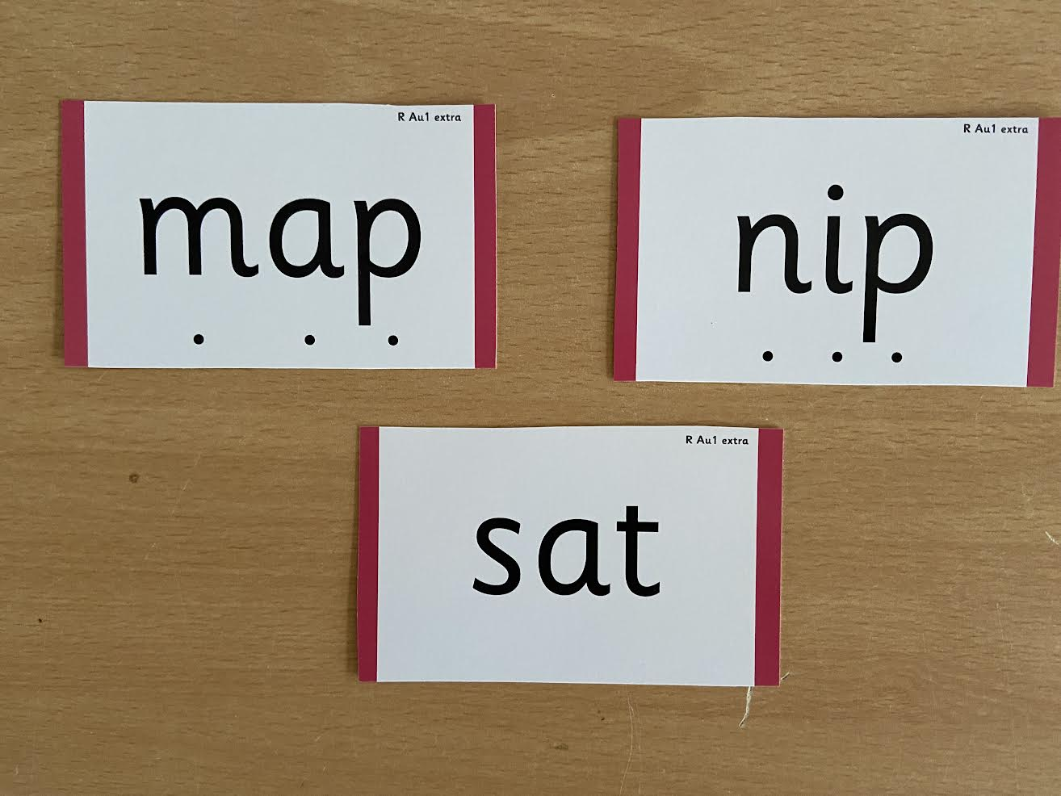
Notes:
During phonics lessons we use Sound buttons so we can sound talk and blend to read

Slide 17
Notes:
Digraphs have a zip to sound talk and blend

Slide 18

Notes:
Words that do not follow the rules and cannot be decoded – tricky words/ exception words
Chn are taught what part of the word is tricky

Slide 19
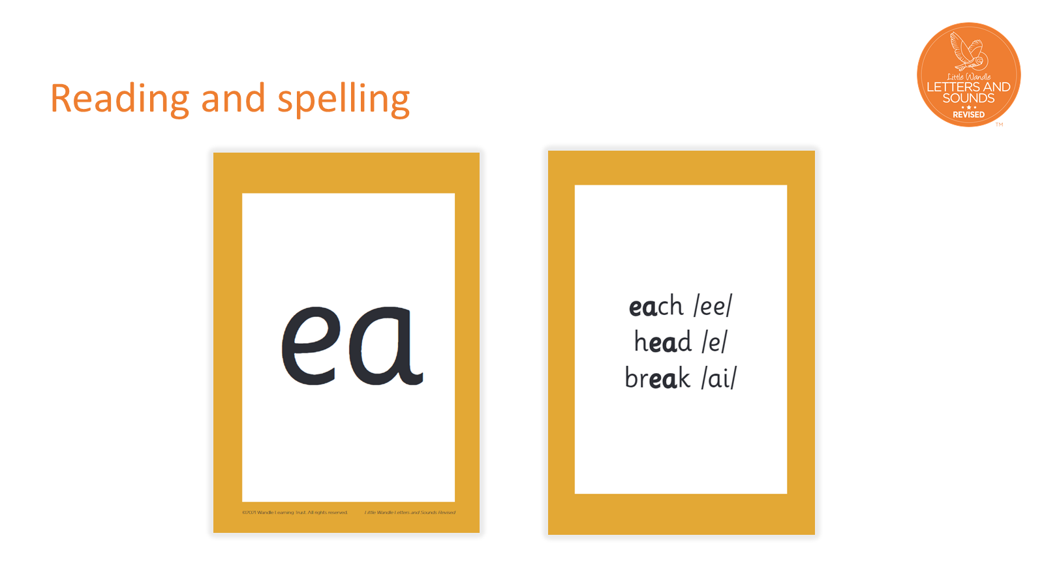
Notes:
This is an example of what the children learn in Year 1.
Children learn that there are graphemes that can have different sounds and sounds that can be made with different letters.
Use the backs and fronts of Phase 5 cards to show ‘ea’ and ‘ow’.

Slide 20
How many different ways to write the phoneme…….
Notes:
sh

Slide 21
And all the different ways to write the phoneme sh:
shell
chef
special
caption
mansion
passion

Slide 22

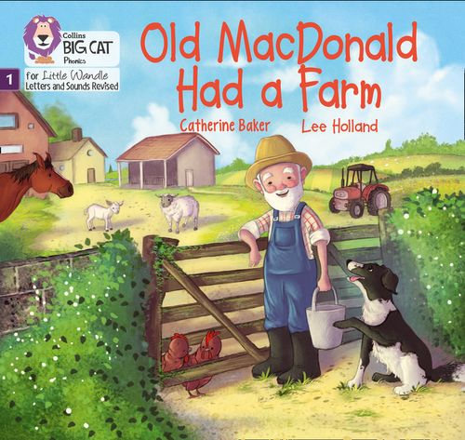
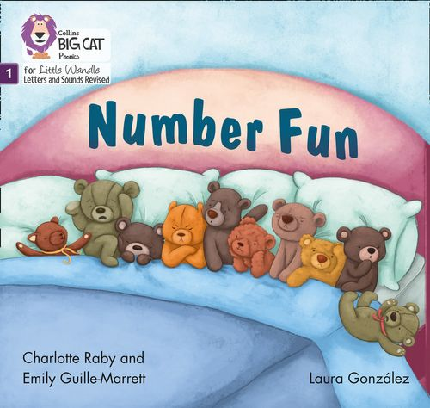
Once children have a secure knowledge of a number of
GPC’s (Grapheme Phoneme Correspondences)
and are confidently blending, they will be ready for
reading books.
Prior to this they may have wordless books which develop
great language skills and teach children the layout of books
and how to handle books.

Slide 23

Reading
We want children to
love reading
Learning to read should be
a positive experience
Reading should be
enjoyable.
We want children to read
for pleasure.
Reading underpins children’s access to the curriculum
and clearly impacts on their achievement
Notes:
We all know how important learning to read is and the impact it has on a childs success - it has to be a positive experience
Whats the reality? Reluctant to read because they find it hard
Frustration stress tears – that’s just the parents
Important to look at the big long term picture

Slide 24

How we teach reading
Reading practice sessions are :
Books are :
matched to children’s
secure phonic knowledge
and word reading
Timetabled 3 times a week
Taught by trained teacher or
teaching assistant
read three times
Taught in small groups
sent home
Notes:
Quite a big difference to how reading was previously taught

Slide 25
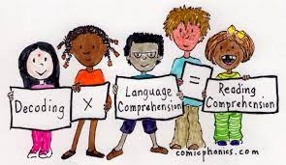
Reading Practice Books carefully matched so children can read
fluently and independently
3 Reads – each one begins with some quick sounds and words practice
Decoding
Prosody
(intonation, expression)
3. Comprehension
When children take their book home to read they should be 95% fluent
Please do not worry that a book is too easy – your child needs to develop
fluency and confidence in reading. Re-reading a book they have had before
helps develop fluency – this is the goal.
Celebrate their success!!!

Slide 26
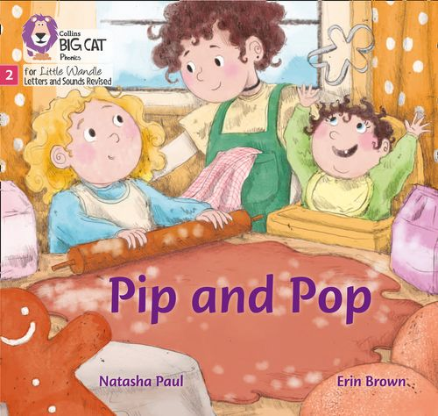

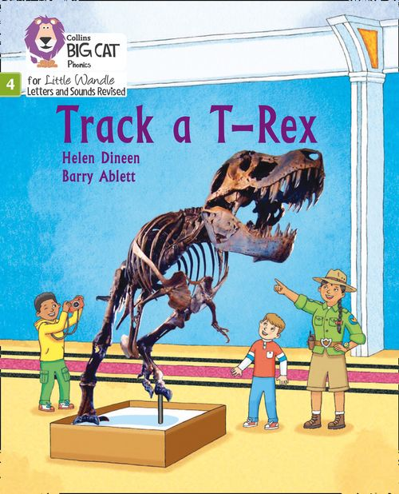
How will this work?
Children are assessed, then LW matches which books
Should be allocated for their secure phonic knowledge
Children will take their Reading Practice Book home
(after reading it 3 times in school)
Teachers will let you know the days books go home and
when they need to be in school to be changed.
Celebrate, praise, talk about the book with you child.
Please make sure books are in book bags so that
we can reallocate books as required
Please look after our books
Notes:
Children will not be changing book multiple times a week as previously
Reading groups will be set up so you will be notified of when your book will be sent home/ need to be back in school
Groups will change!

Slide 27





Big Cat Collins Reading books are carefully matched to children’s
secure phonic knowledge
Notes:
To reiterate - Children will not have books containing GPC’s they have not learned and are not secure with
Look at inside cover

Slide 28




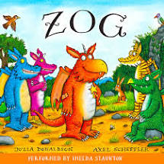
Sharing Book
Children will also bring home a ‘sharing book’ from our class library each week
To become lifelong readers, it is essential that they read for pleasure
Children may not be able to read this book independently but these books offer a wealth of opportunities for talking about the pictures and enjoying the story or information text.
Enjoy the book together and
foster a love of reading
“pair and share”

Slide 29
What else can parents do?
Please look at the Little Wandle videos and guidance for parents
Let your child “show off” their reading to you and celebrate and praise all the way!
Share books with your children for pleasure
Check on your class page for documents to support reading and phonics

Slide 30
Thank you for joining us
Questions ???
https://www.youtube.com/watch?v=g1UW3gnVGkg

