Slide 1
Welcome to Reception

Slide 2
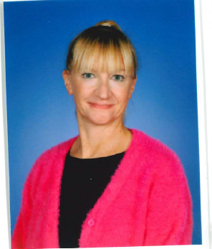
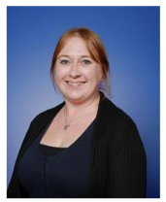
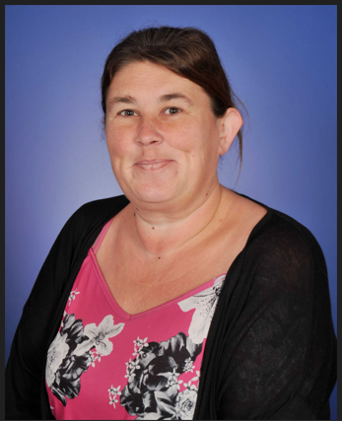
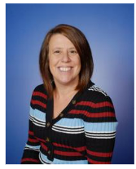
Meet the Staff
Teacher: Miss Cartwright
Learning Support Assistants: Miss Crick and Miss Moxon
Additional staff:
Cover – Mrs Walford
Languages – Madame Rhodes

Slide 3
What is the Early Years Foundation Stage? (EYFS)
The EYFS is a play-based curriculum for children under 5.
The curriculum is organised into seven areas of learning and development, which are divided into:
Prime Areas
Communication and Language
Physical Development
Personal, Social and Emotional Development
Specific Areas
Literacy
Mathematics
Understanding the World
Expressive Arts and Design
The play-based curriculum enables teachers to spend more quality time with children and develop high-quality interactions that support, challenge and scaffold learning across all seven areas of development.

Slide 4
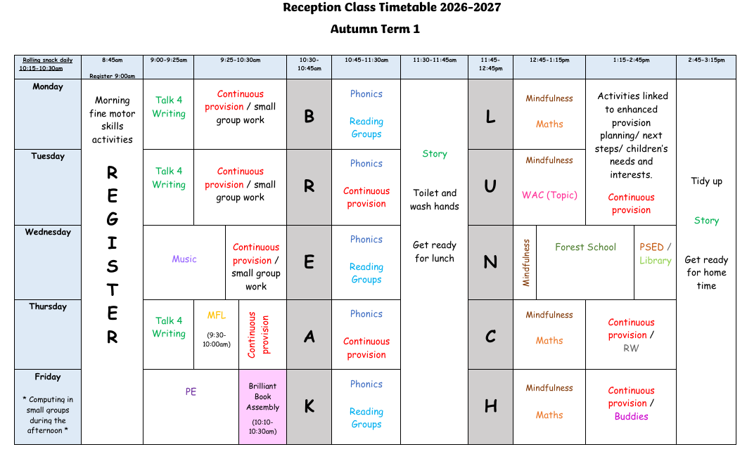
A typical week…

Slide 5
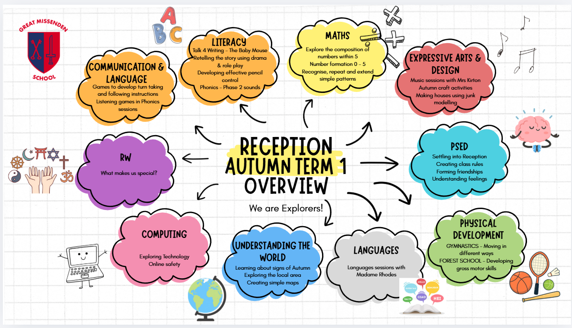
What will we be learning?

Slide 6
Forest School –
WEDNESDAY AFTERNOONS
Children will attend Forest School once a week.
Please bring your child in their school uniform with Forest School clothes in a bag (eg. waterproofs/ jumpers/ layers).
Welly boots can be kept at school.
Please make sure everything is clearly labelled.

Slide 7
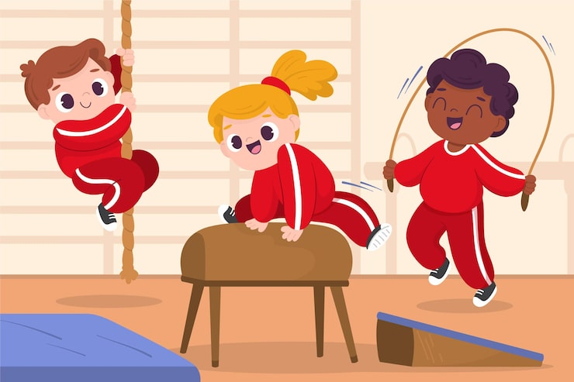
PE
PE is on a Friday morning (Children wear their PE kit for the whole day)
This half term our focus will be Gymnastics. We will be exploring different ways of moving across the mats and apparatus.

Slide 8
The First Half Term
We will find out what the children can already do and what they know. This information will be used to help us develop individual learning programmes for each child.
Child initiated learning throughout the week, gradually building to the adult-led activities.
Phase 2 Phonics
Reading books – changed every Friday
We spend lots of time talking to the children about what they are learning and record WOW moments on Tapestry.
We will focus on helping children understand and follow our three school rules: being Ready, Respectful and Safe. Positive behaviour is recognised and celebrated, encouraging children to make good choices.

Slide 9
Reading and Assessments
Wordless books – language and comprehension skills
Phonics – Week 2 of Reception, starting with s a t p i n
Reception Baseline Assessment’s are carried out within the first two weeks of your child starting Reception.
The information from this short assessment will enable me to plan your child’s next steps and learning opportunities.
Phonic assessments are carried out at the end of every half term.

Slide 10

Tapestry
It is used for children settling in, parent communication and WOW moments.
You will receive an email to set up an account.
Please add photos of what you get up to as a talking point for your child.
We have ‘share my news’ every half term.

Slide 11
Bookbags
Reading books and Reading Records
Water bottles – clearly labelled
Lunch box (if needed)
Spare clothes
Label everything!
Snack is provided daily - Fruit in the morning
Milk at 2:00pm

Slide 12
Uniform
Winter uniform
White short-sleeved polo shirt (polo shirt with school logo is optional)Navy sweatshirt or cardigan with school logo
Dark grey school trousers or shorts
Dark grey skirt (knee length)
Smart black shoes
Dark grey socks or tights
Reception and KS1 children may wear a dark grey tunic with a plain white polo shirt
Reception and KS1 children must have a Great Missenden School bookbag (available at PL Schoolwear). KS2 children may bring an appropriate bag of their choice.
Coats should be warm and waterproof.
Summer uniform
As above
Blue gingham summer dress (worn with white socks)

Slide 13
Uniform
Regulation school PE kit
Dark / light blue sports polo with school logo
Navy shorts or skort
Navy / light blue sports socks
Navy tracksuit may be worn for outdoor sports in winter (logo optional)
Indoor PE is performed in bare feet
Trainers for outdoor PE and games
Other information
Long hair must be tied back at all times
Navy or black hairbands only
No jewellery (except earrings - see below)
Small, plain stud earrings only. They must be removed or covered with tape for PE.
All items of uniform, PE kit and school bags must be clearly labelled with the pupil’s name and class.

Slide 14

Arbor
Please check you have updated consents on Arbor.
Thank you

Slide 15
Dates for your diary
AUGUST
Monday 31st August – 'Stay and Play' session (10:00am-12:00)
SEPTEMBER
Tuesday 2nd September - INSET Day
Wednesday 3rd September - Start of Autumn Term
Meet the Teacher (3:30pm)
Saturday 12th September - PTA Colour Run (1:30-5:00pm)
Wednesday 16th September – First Forest School session
Friday 18th September - Dahlicious Day (Dress up)
wb. 21st September - Little City experience (mobile role play)
Friday 25th September – EYFS Local Walk

Slide 16
Dates for your diary
OCTOBER
Friday 2nd October - Individual photos
Wednesday 7th October– Flu vaccinations
Friday 16th October - Sibling photos
wb. 19th October – EYFS Explorers Week
Friday 23rd October - EYFS Explorers Dress up day
Break up for Half Term
wb. Monday 26th October - Half Term
Please keep an eye on the weekly school newsletter for further important dates.

Slide 17
If you have any questions, please email Miss Cartwright receptionclass@gmglt.co.uk

